Slide 1
EveryHome Program Update
July 2019

Slide 2
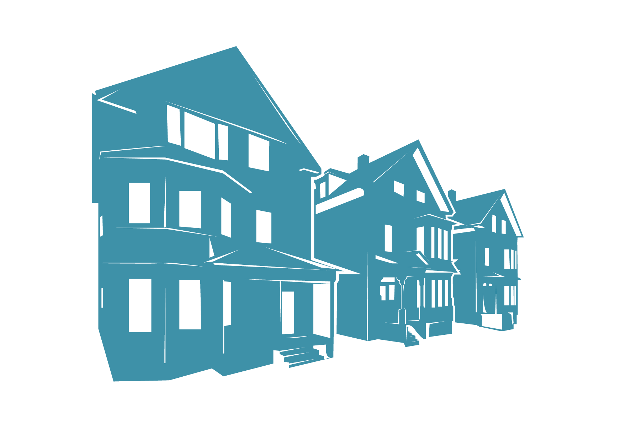
EveryHome
Eliminating vacant & abandoned property in the City of Providence

Slide 3
Summary
Created by Mayor Jorge Elorza in 2015
Suite of tools to rehabilitate vacant and abandoned properties
The goal is to rehabilitate every vacant home in Providence while supporting local employment
Notes:
In 2015, Mayor Jorge Elorza created the EveryHome program in an effort to revitalize and fill every abandoned home in the City of Providence. Since its inception, the City has been utilizing a suite of tools to bring the City’s vacant and abandoned residential properties back into productive reuse. As the suite of tools evolves to best fit residents’ needs, EveryHome works to protect, restore and renew Providence’s neighborhoods.

Slide 4
SUCCESS PROPERTIES
600

Slide 5
SUCCESS PROPERTIES: Breakdown
DIS POLICY CHANGES = 145
HOUSING COURT = 94
TRANSFER AFFIDAVIT = 41
RECEIVERSHIP = 35
MARKET TRENDS & REACTION TO POLICY CHANGES = 285

Slide 6
PROPERTIES IN PROGRESS Vacant with no violations
142

Slide 7
TOOLS
EveryHome’s suite of tools include:
Policy Changes
Code Enforcement
Housing Court Prosecution
Receivership
Special Redevelopment Plan & construction lending
Financial Assistance
Home Repair
Down Payment Assistance
Lead Safe Providence Program
Federal Development Subsidy

Slide 8
POLICY CHANGES
Code Enforcement
Housing Court Prosecution
Two key changes:
The City now holds all parties with an interest in the property responsible, including banks and other mortgage holders.
Transfer affidavits: All sellers of properties with outstanding code violations must provide a copy of the violations to the buyers. Must also provide the City with an transfer affidavit, signed by the buyers, acknowledging the violations and accepting full responsibility for all repairs in a timely manner.
Notes:
The City has made aggressive prosecution of housing code violations a top priority and is now holding all parties with an interest in the property responsible for abating the violations. This includes not just the party named on the deed, but also banks and other mortgage holders.
Transfer affidavits prevent vacant and substandard properties from being sold without addressing outstanding housing code violations.

Slide 9
RECEIVERSHIP
Court appoints a receiver who facilitates repairs to abandoned, rundown properties.
The City petitions the court to appoint a receiver.
Receiver is appointed if court finds that:
outstanding code violations exist
the home constitutes a public nuisance
the owner has been given an opportunity to correct the violation and has refused or failed to do so
PRA as Receiver:
-- New model underway with two properties.
Notes:
*Abutters can also petition properties into receivership

Slide 10
SPECIAL REDEVELOPMENT PLAN
The Providence Redevelopment Agency (“PRA”) passed a Redevelopment Plan that was approved by City Council to facilitate the rehabilitation of vacant and likely abandoned houses throughout the City.
The Redevelopment Plan authorizes the PRA to acquire these vacant properties and return them to productive use.
The PRA will only acquire properties that are abandoned, vacant and blighted.
Notes:
The status of properties can change, violations can be abated, and vacant houses can return to productive use. Prior to initiating acquisition of any properties, City staff will conduct a field visit to confirm that the blight and substandard conditions originally identified still exist.

Slide 11
Special Redevelopment Plan
Round 1 and Round 2 Updates
Round 1: 13/15 properties have commenced rehabilitation; 2 are pending transfer
Round 2: All 5 have been redeemed by interested parties
We are moving forward to add 86 additional properties to the Redevelopment Plan
Round 3: Beginning process to board vacant properties that have been vacant for more than one year

Slide 12
FINANCIAL ASSISTANCE
CDBG Home Repair Program
Loan program offering deferred payment, 0% interest loans to low/moderate income homeowners to make repairs such as roofing, electrical, and other code and safety violations.
These loans keep homeowners in their homes and prevent additional properties from becoming vacant and abandoned.
111 units & counting rehabbed since 2015.
HOME Down Payment & Closing Cost Assistance Program
Program providing a no-interest, forgivable loan to low/moderate income homeowners to purchase a home in Providence.
56 homes & counting purchased since 2015.

Slide 13
FINANCIAL ASSISTANCE
Lead Safe Providence Program
Loan program offering forgivable, 0% interest loans to low/moderate income homeowners to make properties “lead-safe.” Loans for owner-occupied homes are forgivable after five years; loans for non-owner occupied properties are forgivable after ten years. Assistance for other “healthy housing” issues (such as mold and radon) also provided.
269 units & counting made lead-safe since 2015.
Federal Development Subsidy
Strategic investments of federal funds are being made to rehabilitate, demolish and/or redevelop vacant and abandoned properties to support viable redevelopment. CDBG and HOME funds continue to be used for-
Substantial rehabilitation,
Demolition to remove blight and hazards in neighborhoods, and/or
New construction of affordable housing on vacant lots.

Slide 14
ADD’L FINANCIAL TOOL
Revolving Fund
Whenever an owner, operator, or agent of a dwelling... neglects or refuses to make repairs or other corrective action... the enforcing officer may undertake the repairs or action, when in his or her judgment a failure to make them will endanger the public health, safety, or welfare….
Winter Policy
Emergency work
Emergency housing
Case Worker RFP being drafted
Amount Spent
Current Balance
Moving legislative changes forward

Slide 15
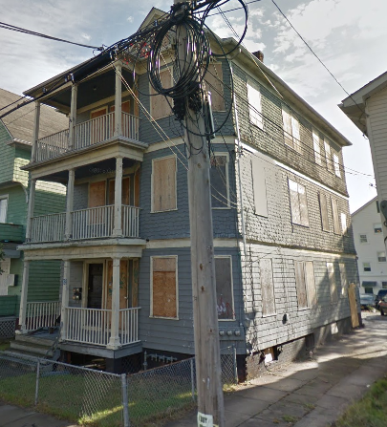
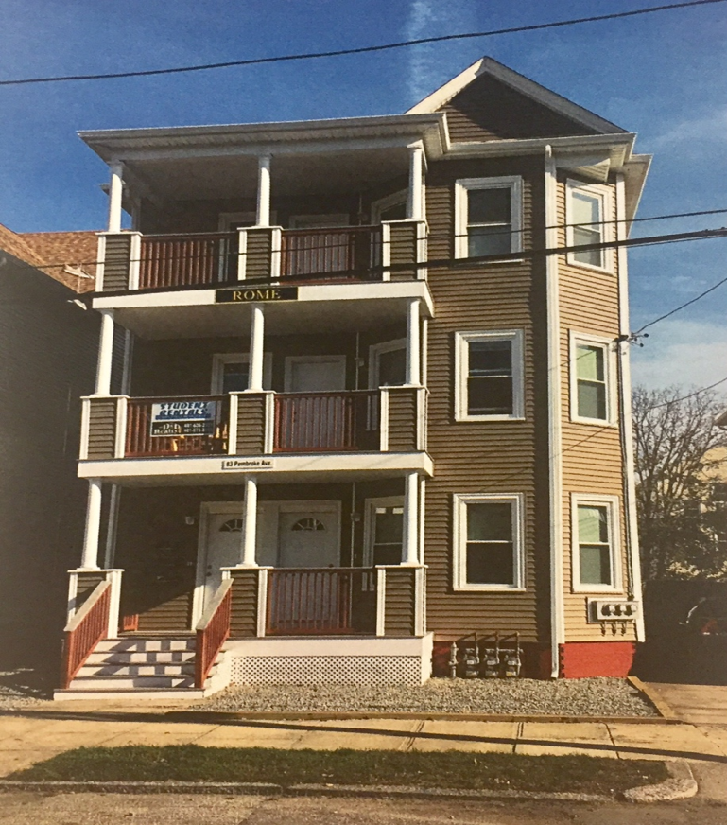
83 Pembroke

Slide 16
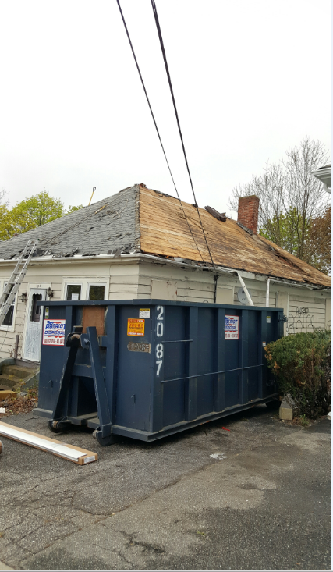
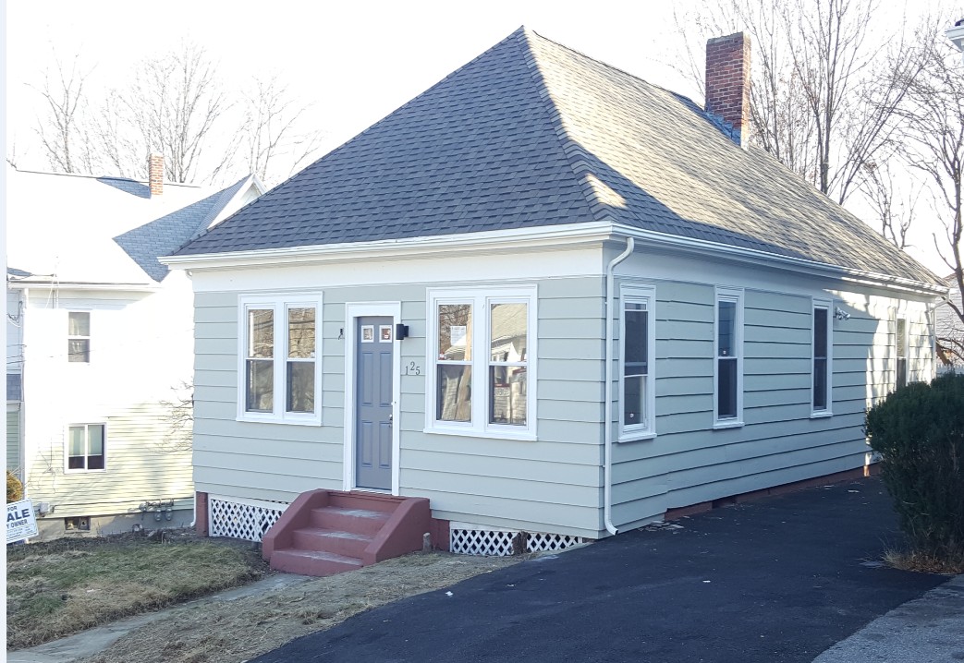
125 Hazael Street

Slide 17
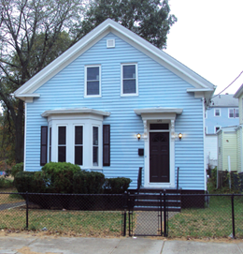
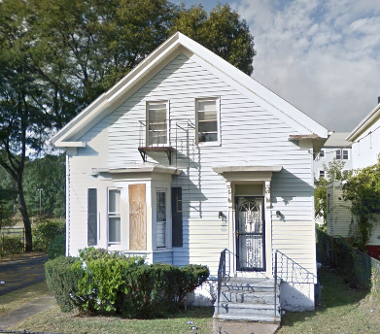
120 Camden Avenue

Slide 18
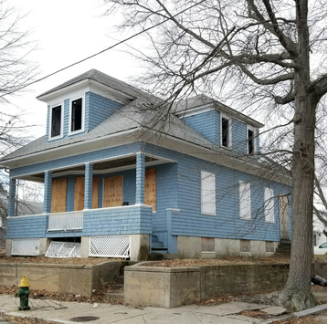
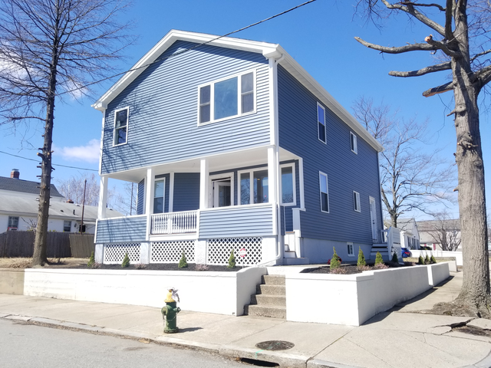
86 Messina Street

