Slide 1
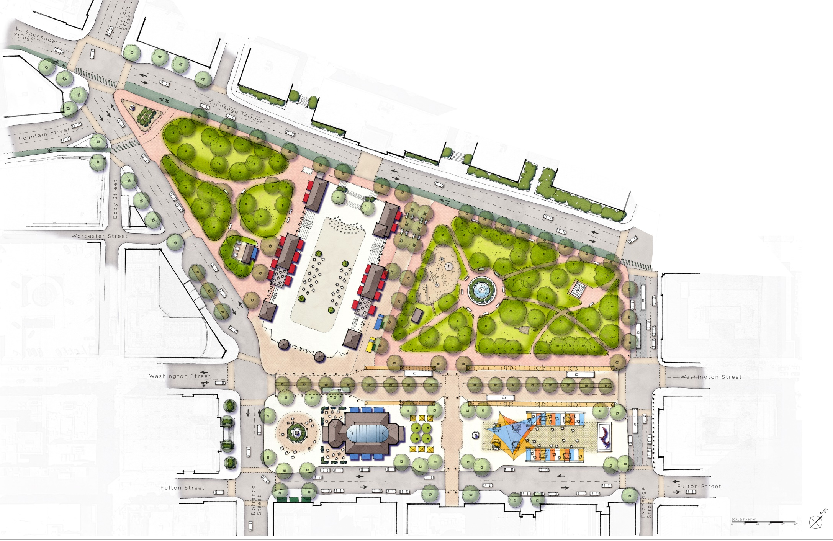
Kennedy Plaza Master Plan

Slide 2
$2,700,000
State Transportation Improvement Program
$500,000
Capital Improvement Program
$300,000
Additional Placemaking Improvements

Slide 3
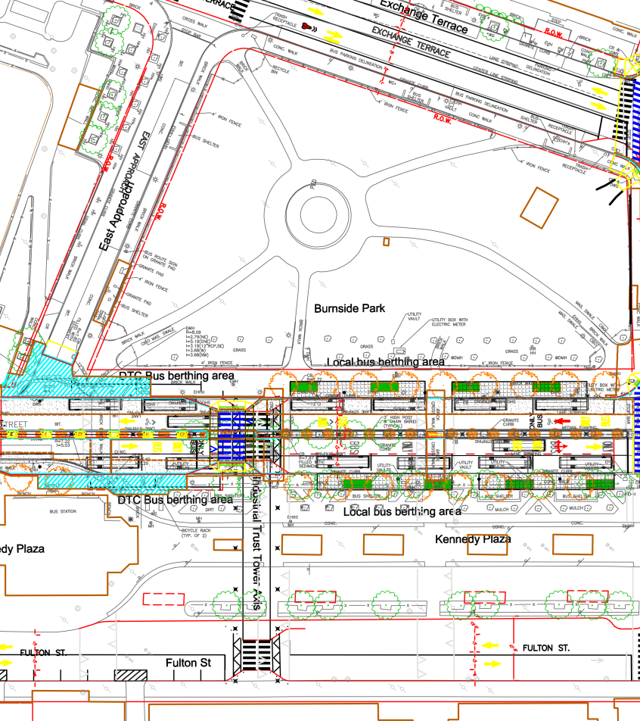
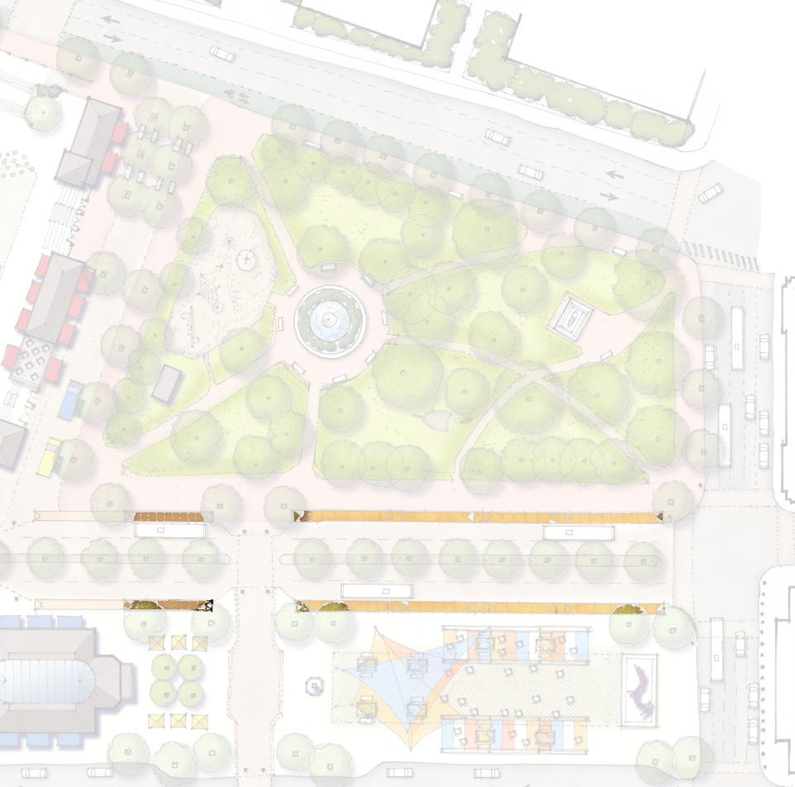
Bus Shelter Relocation
RIPTA shelters on Exchange Terrace and East Approach will be removed
RIPTA Stop G and H shelters will be relocated to the south side of Washington Street
Existing RIPTA shelters on Fulton Street will be relocated to the north side of Washington Street

Slide 4
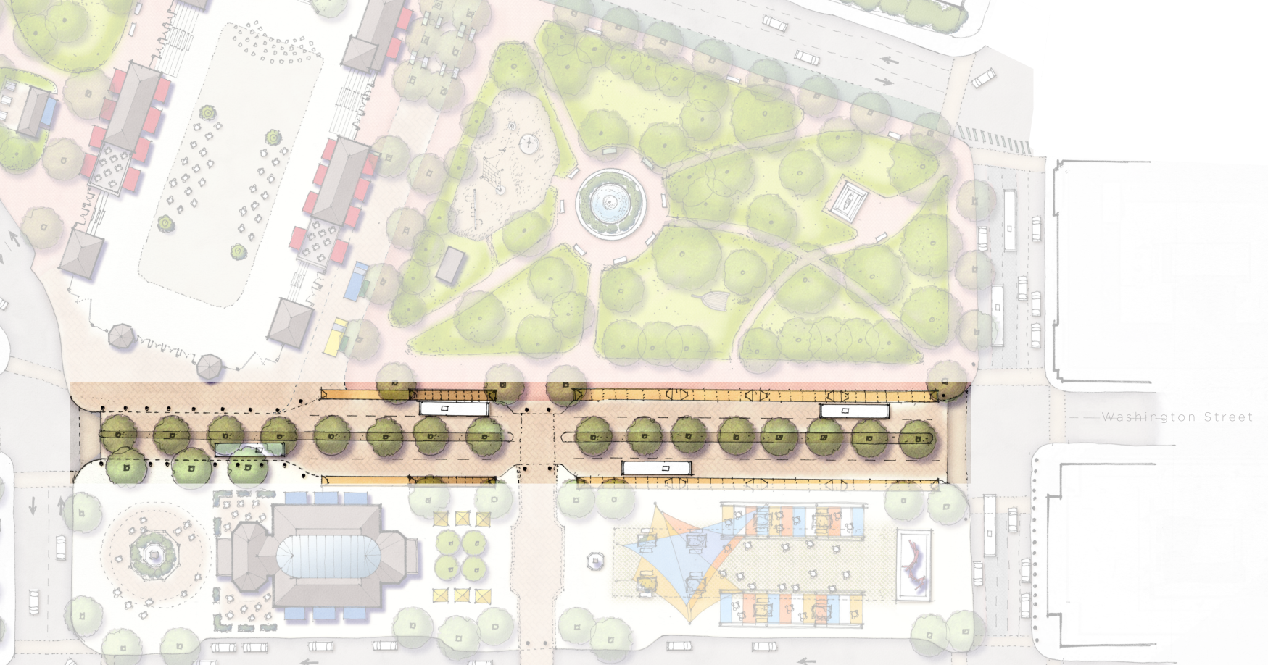
Enhanced Median on Washington
The enhanced median will include plantings, bollards, and ornate light fixtures. The median will also accommodate the midblock crosswalk through the plaza.

Slide 5
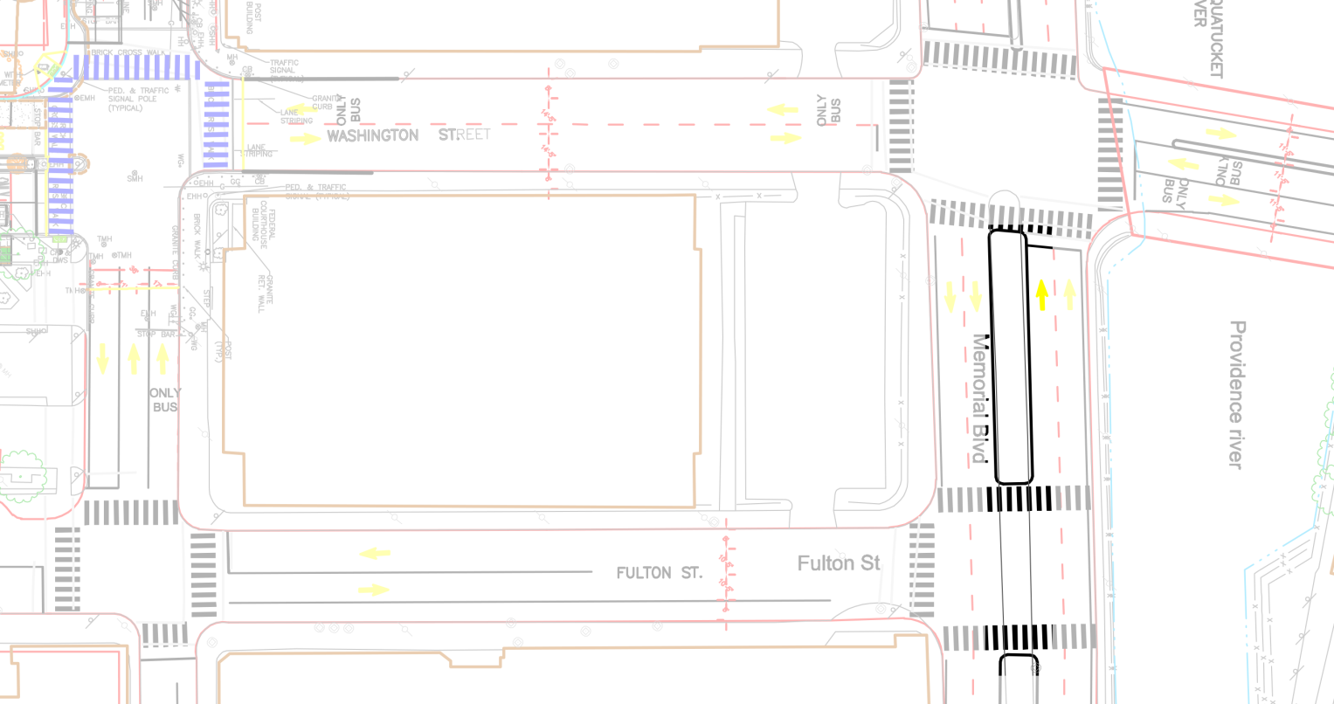
Memorial/Fulton
A break in the median at the Memorial/Fulton intersection will be added to allow left turns from Memorial to Fulton and from Fulton to Memorial

Slide 6
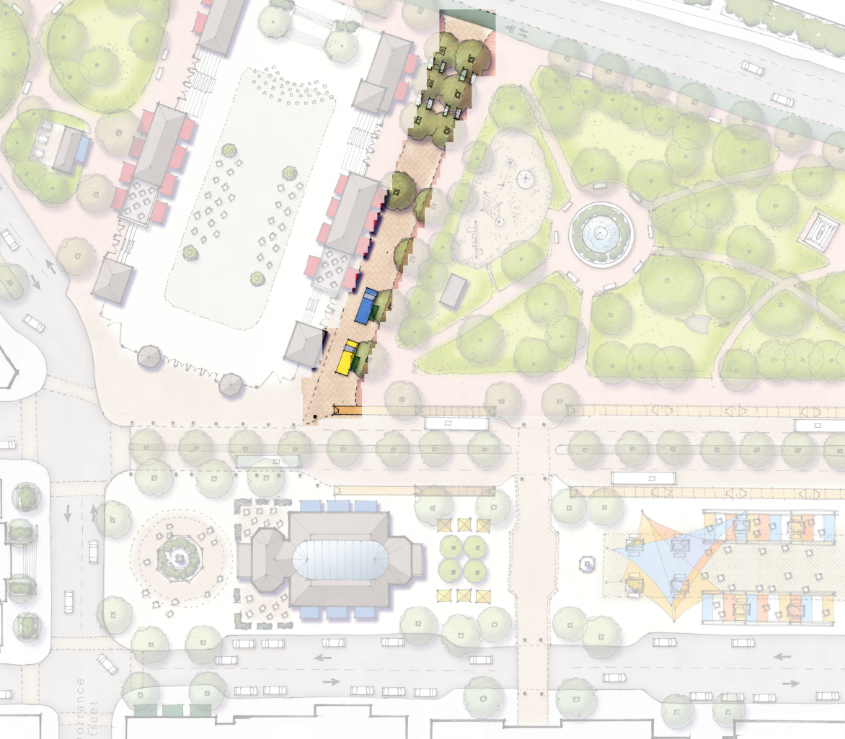
East Approach
East Approach will be raised to sidewalk level and closed to vehicle traffic to provide a better connection between Burnside Park and the Alex & Ani Skating Rink.

Slide 7
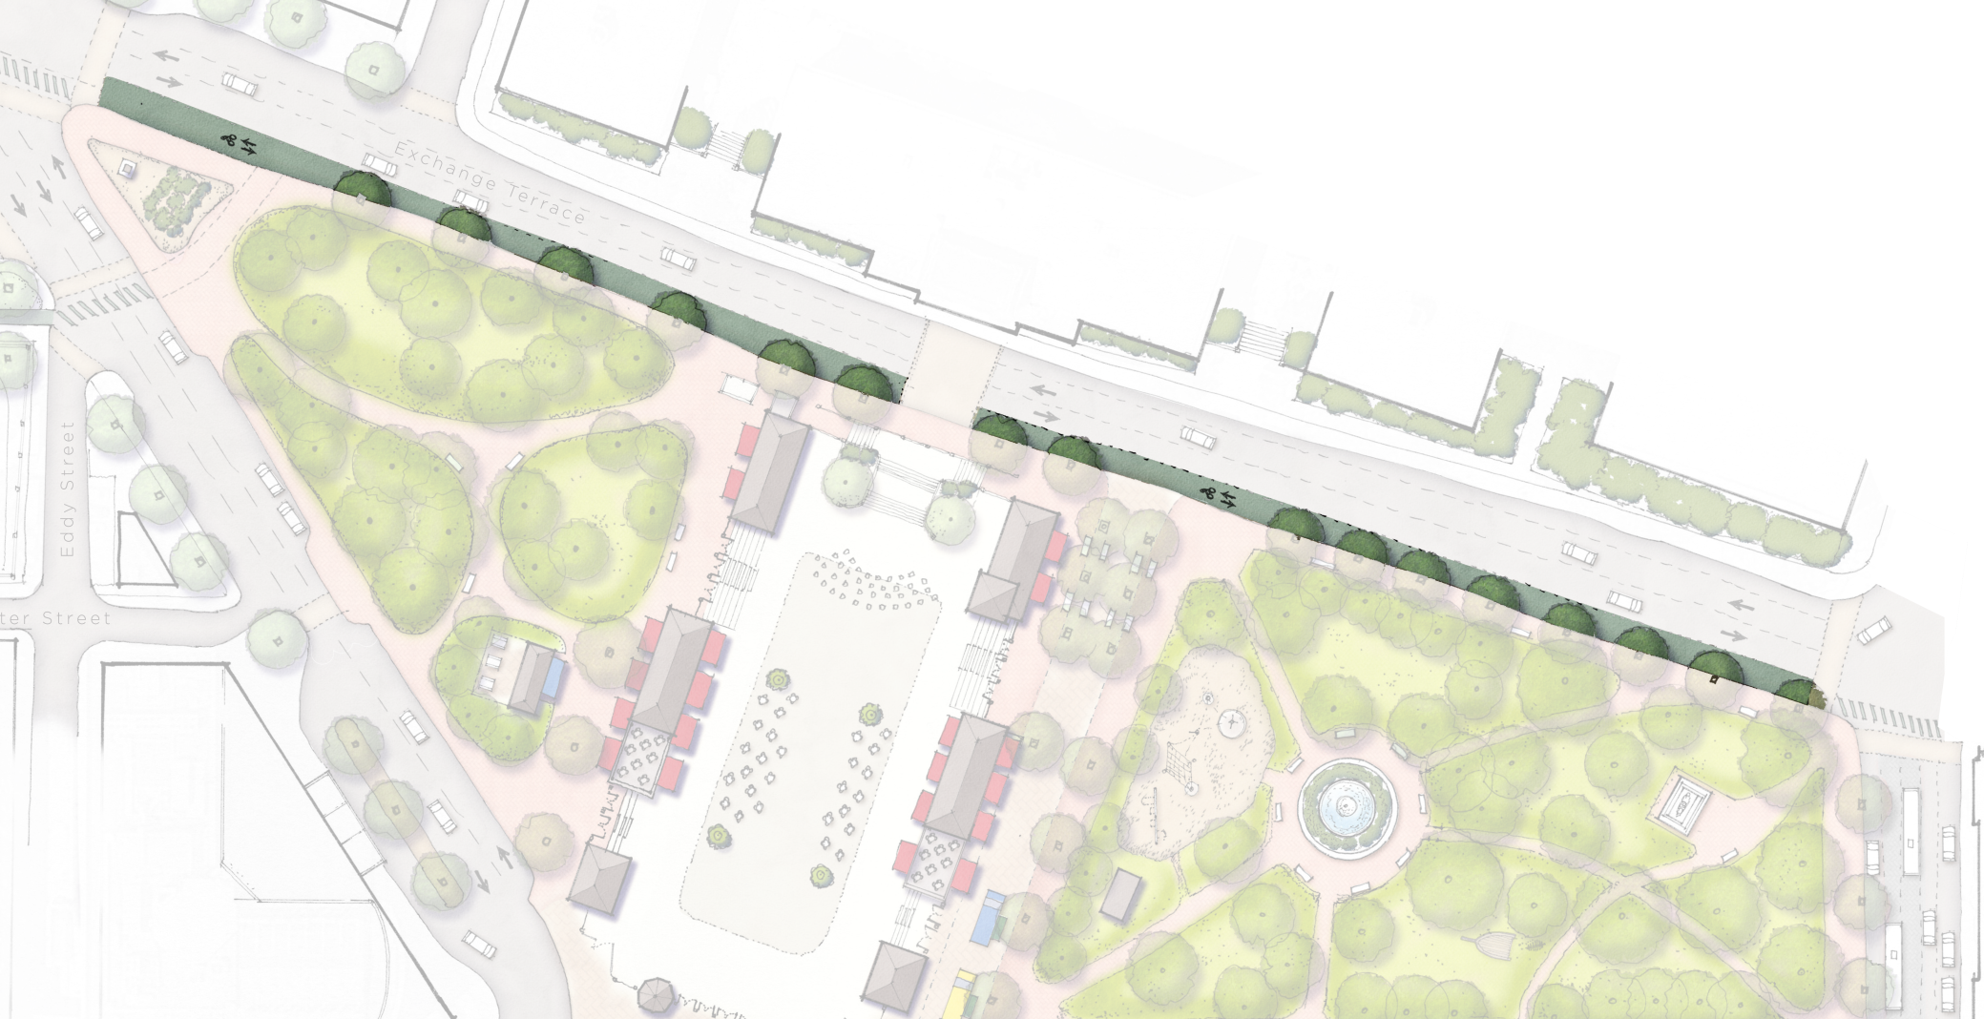
Exchange Terrace Two-Way Protected Bike Lane
Removal of RIPTA bus stops Y and Z on Exchange Terrace will create space needed for the two-way bicycle facility.

Slide 8
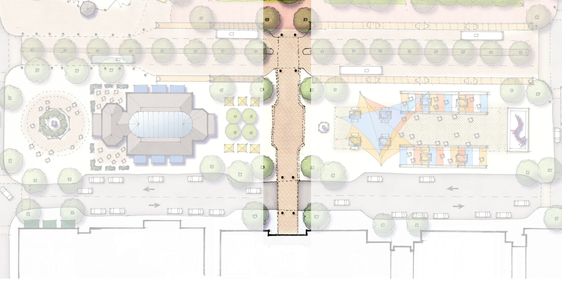
Mid-Block Crosswalk 111 Westminster St. and Fulton
The new crossing will match the mid-block crossing being constructed across Washington Street as part of RIPTA’s DTC project.

Slide 9
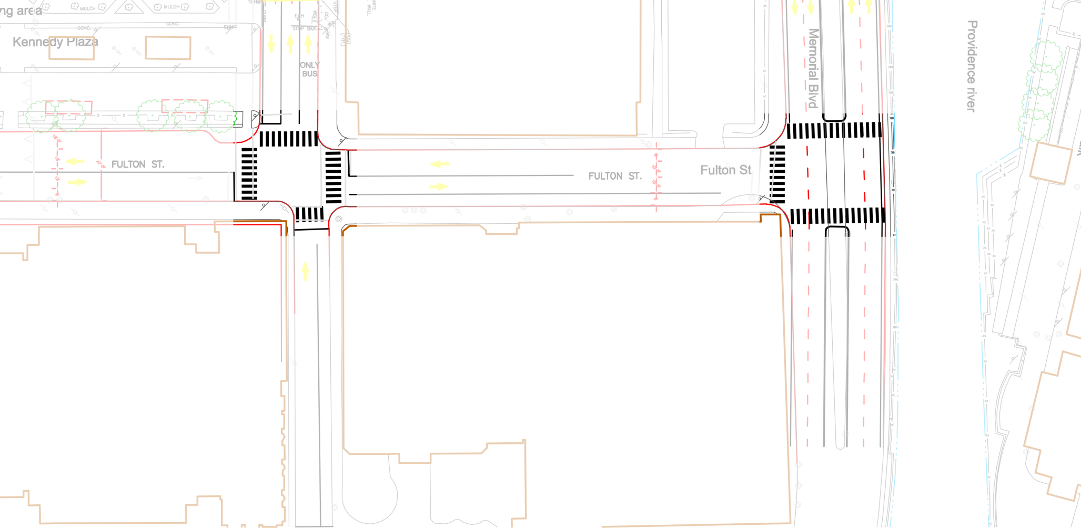
Enhanced Crosswalks at Fulton/Memorial and Fulton/Exchange
Piano key crosswalks enhance safety for pedestrians by making the crossings highly visible to drivers.

Slide 10
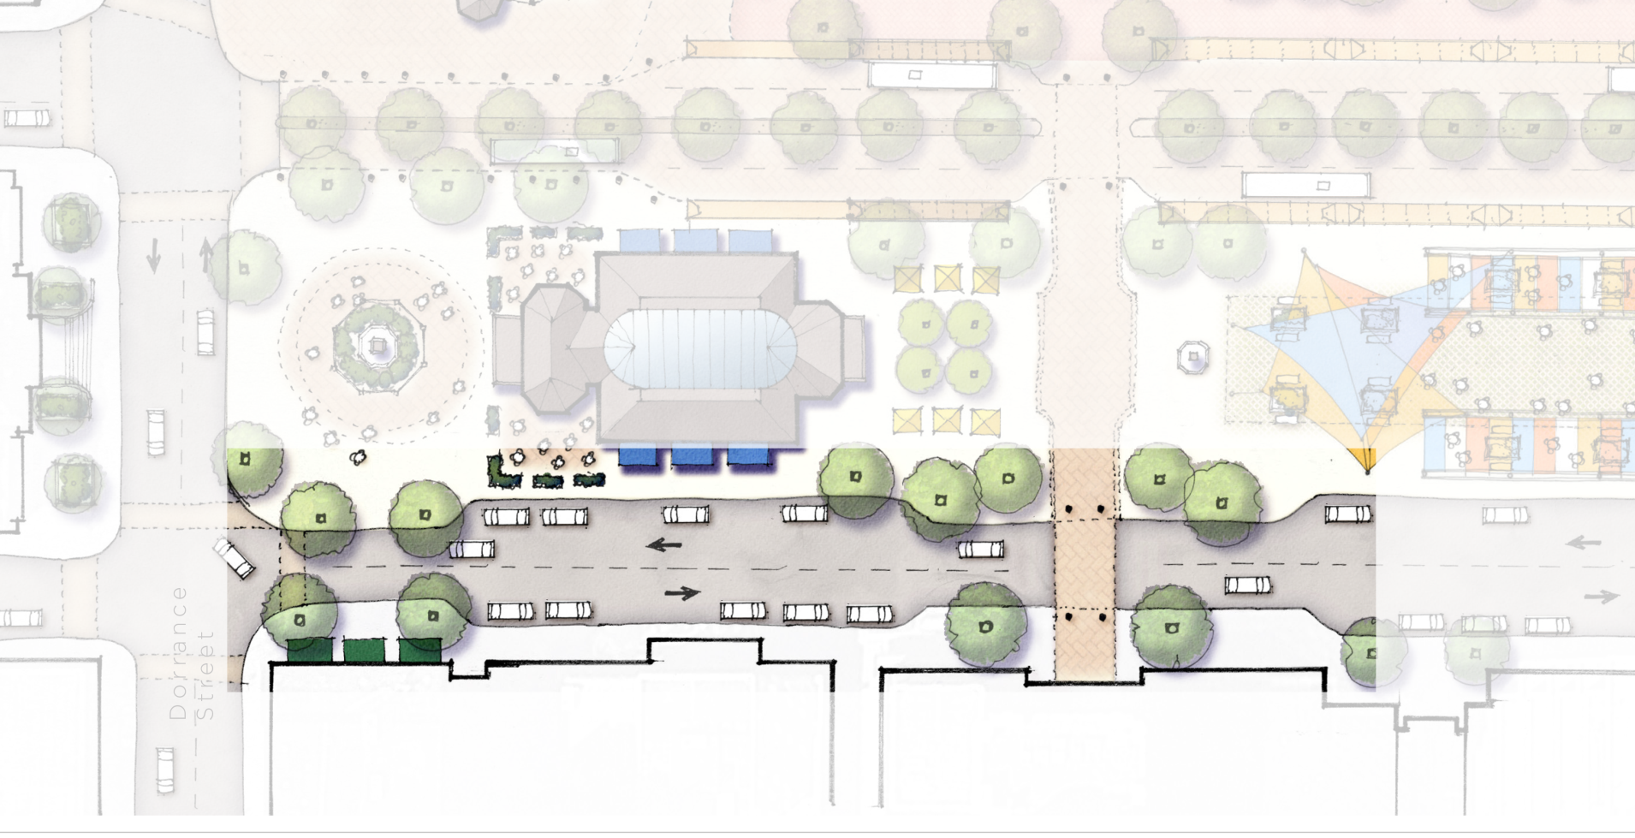
Curb Modifications on Fulton Street
Pedestrian safety will be enhanced and vehicle parking will be created on Fulton Street by constructing curb extensions at the new mid-block crossing.

Slide 11
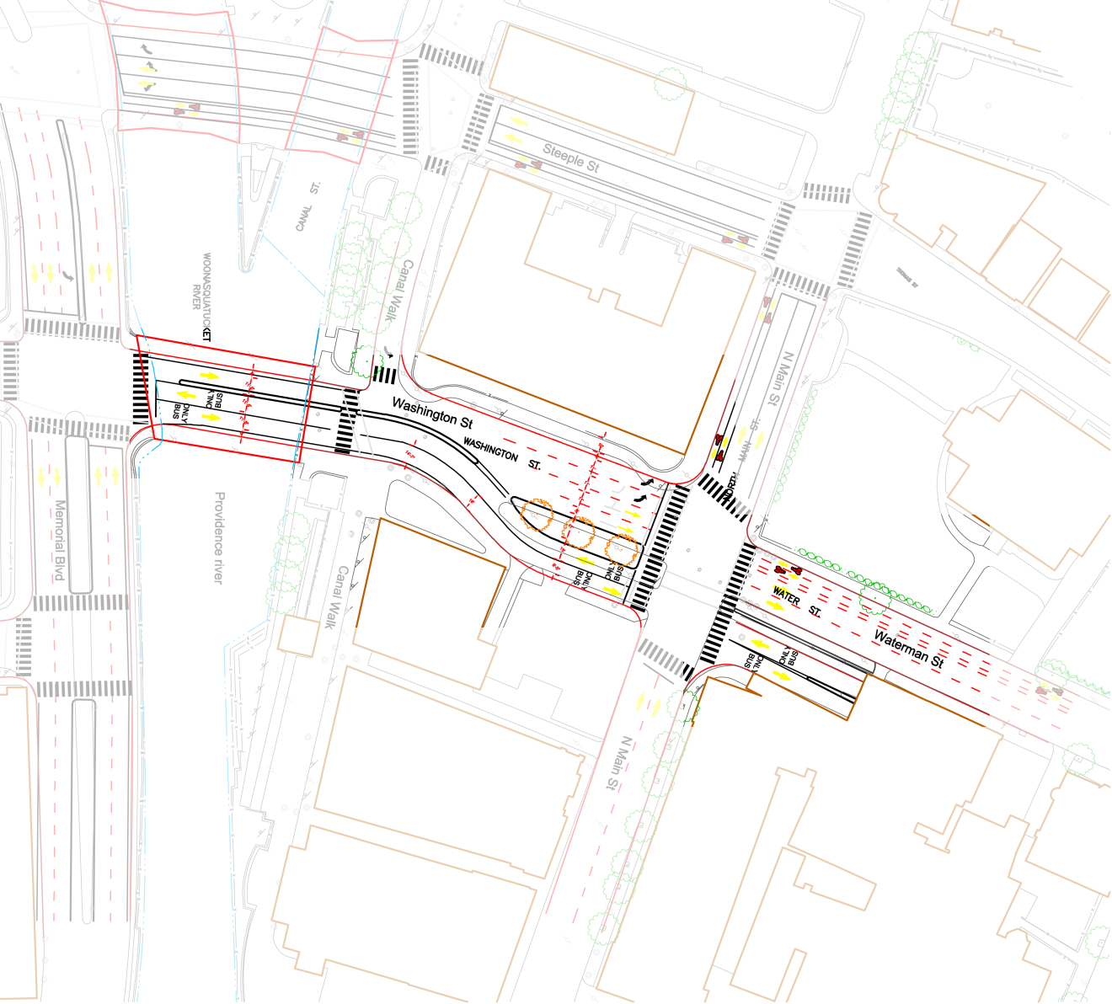
Bus Only Lanes and Bus Island on Washington Street

Slide 12
Traffic Signal Modifications
Fulton/Exchange
Washington/Memorial
N. Main/Waterman
Washington/Exchange
Fulton/Memorial

Slide 13
Additional Amenities
Relocate existing bus ticketing/fare machines
Design and install new wayfinding signage
Install decorative lighting to ensure safety throughout the plaza

Slide 14
Project Timeline
Spring 2018: BETA Group, Inc. contracted for Design and Engineering Services
November 2018: Design and engineering to be completed
Winter 2018/2019: Construction goes out to bid
Spring 2019: Construction contract awarded; construction begins

