Slide 1


Slide 2
Time Table
Advertisement | Monday, November 9, 2020
Bidder’s Conference | November 18, 2020 @ 1pm
Deadline for Questions | Friday, November 18, 2020
Final Q & A Published | Monday , November 23, 2020
RFP Deadline | Monday, December 7, 2020 BEFORE 2:15 pm
Proposals Due: Monday, December 7, 2020 up to 2:15 pm at the Department of the City Clerk, Room 311, City Hall, Providence, RI. At 2:15 all bids will be publicly opened and read at the Board of Contract Meeting at City Council Chambers, on the 3rd floor of City Hall.
Funding Provider Decision | Monday, January 2021
Notes:
Explain how questions are to be submitted and the answers posted
Explain the award process

Slide 3
Purpose
Integrate youth development principles into work-based experiences and/or project-based service learning for young people.
Provide opportunities for youth to understand career pathways and decision points, including the linkages between educational attainment, relevant experience, demonstrable skills and career advancement.
Include meaningful opportunities for youth leadership and reflection on the personal and social impact of their work.

Slide 4
Eligible Applicants
Established community-based organizations
Private non-profit agencies/institutions
Private for-profit companies
Public agencies
Educational institutions including a non-traditional public secondary school or career and technical education.
Collaboration amongst organizations is strongly encouraged.

Slide 5
Industry Priorities
Priority for specific industries in :
Education
Healthcare
Information Technology
Transportation.

Slide 6
Target Populations
The Office of Economic Opportunity will seek proposals that address the needs of our diverse youth population. For this reason, and includes priorities for and limited to:
Current or previous justice involved Youth
Homeless Youth
Foster care youth
Out of School Youth
In School Youth is limited to youth from the following schools:
Mt. Pleasant High School
Hope High School
Central High School
Dr. Jorge Alvarez High School

Slide 7
Contract Terms
Performance Period is from January 2021 at the earliest to June 2021.
Providers are required to attend a 90-minute provider group meeting every month from January 20201 to June 2021

Slide 8
Program Design Models
1. Work Experience placements
(WEX)
2. Service Learning projects (SL)
Designed for youth with some prior project-based career exploration or work experience
After work readiness, each participant will be placed in a Work-Based Learning (WBL) opportunity with an employer(s) the provider has recruited.
Designed for youth with little or no prior career exploration or work experience.
Service-learning is an approach to teaching and learning in which students use academic knowledge and skills to address genuine community needs.

Slide 9
Payments to Youth:
Through provider’s payroll, at the 2020 minimum wage of $10.50 per hour, regardless of their age, for a maximum number of 200 hours per program slot.
Programs may propose to pay youth above the minimum wage, but under this RFP, the maximum reimbursement the provider may invoice for is $10.50 per hour.
Awarded programs must pay youth each week.

Slide 10
Payments to Providers:
Bidders who submit applications must have the financial capacity to pay program costs up front (including youth wages) and receive reimbursement upon submission of invoices with backup documentation.
Bidder organization agrees to have the financial resources to pay program costs (not including youth wages) up front and receive reimbursement after submission of invoices, reports and other required materials. The reimbursement timeline will be finalized during contract negotiation.

Slide 11
Payments to Providers
This is a REIMBURSEMENT grant, so we require back-up documentation and approval before processing payments.
The reimbursement timeline will be finalized during contract negotiation.
Under no circumstances will the Contractor receive reimbursement for any amount that exceeds the maximum contracted amount.

Slide 12
Narrative Response
Part A: Identifying Information
Part B: Agency Experiences/Qualifications
Part C: Program Design
Part D: Budget

Slide 13
Narrative Response
A.
Identifying Information Statement of Need on
B.
Agency Background and Capacity
C.
Program Design
D.
Budget
Notes:
://www.providenceri.gov/oeo/city-summer-program/.

Slide 14
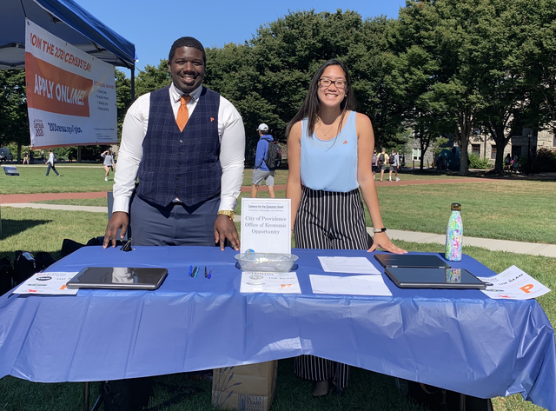
Selection Process
1. Initial Review
2. Technical Review
3. Award Process
4. City of Providence Council Approval
Notes:
Submit one original and six copies of the proposal to the BOC City Clerk Office at Providence City Hall by 2:00pm on Monday, February 3.
Must be signed by an individual authorized to represent the organization
Narrative parts should be formatted with 1 inch margins in 12 point font in a 1.5 spaced format
Please number the pages
Respond in the same order as the RFP for ease of scoring
Please do not submit any exhibits or addenda not requested.
A separate proposal is required for each training proposed.

Slide 15
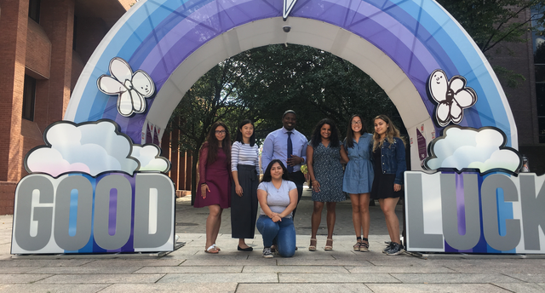
On behalf of OEO
We look forward to reading your proposals and working with you for Spring 2021.

