Slide 1
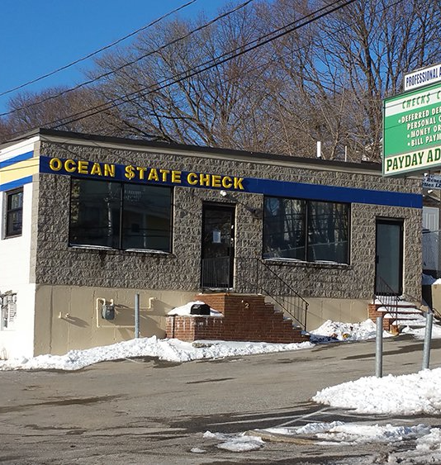
52 River Ave proposal for development

Slide 2
52 River Ave. development team
Daniel Shedd, Prospective Owner
50-year manufacturing entrepreneur (retired)
Board Member, Rhode Island Manufacturing Association (RIMA)
Board Member, Print Industries of New England (PINE)
Fundraiser, Highlander Charter School
Mentor, DesignXRI
Lifelong Rhode Islander, and current Providence resident
Marken Shedd, Project Coordinator
Dan’s daughter and longtime Providence resident
Ed Wojcik, Architect
Principal architect of Providence-based firm
Shelito Vincent, Prospective Tenant
Professional Boxer
Longtime mentee and friend of Dan

Slide 3
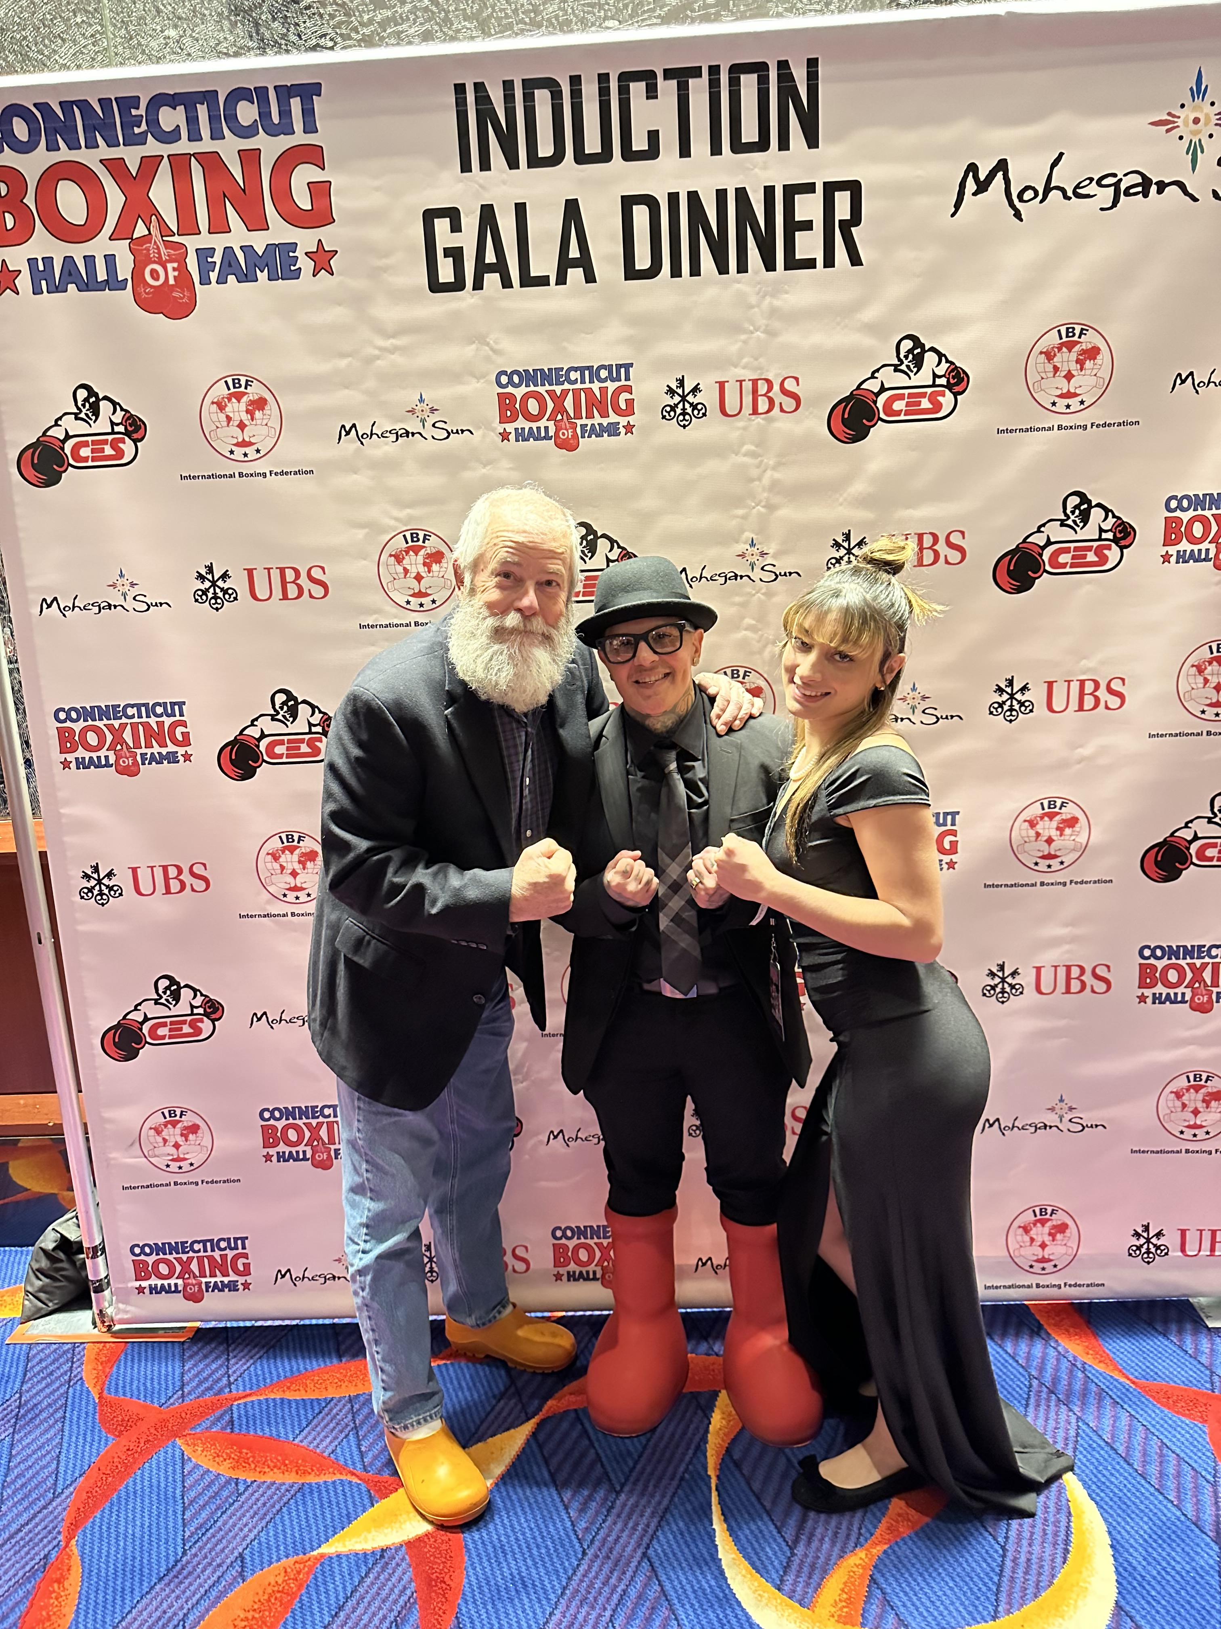
52 River Ave. our mission: Shelito’s Way Boxing Gym
Dan, Shelito and her daughter at Shelito’s induction into the CT Hall of Fame.
Shelito Vincent is a title-winning boxing champion from Rhode Island. She was one of the first female boxers televised nationally in a fight and was recently the first female fighter inducted into the CT Boxing Hall of Fame. She is a proud lesbian and advocate for her LGBTQ+ community and women in the male-dominated sport.
Shelito achieved all of this despite her journey through sexual abuse, depression, and addiction because of the transformative power of her sport. She has been sharing that powerful message by mentoring and coaching other aspiring professional and amateur boxers.
Shelito plans to build a new boxing gym to expand on her current work, and Dan is going to support that mission as her landlord.

Slide 4
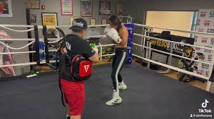
52 River Ave. our mission: Shelito’s Way Boxing Gym
The gym will be equal parts Health club and Boxing studio. It will offer strength training equipment, cardio equipment, boxing training equipment, member amenities (lockers, bathrooms, etc.), and a full-size boxing ring.
Aside from serving the community health through fitness access, the gym will offer programs in:
Youth Boxing
Women’s Self-Defense
Adult Boxing Fitness Classes
Advanced Boxing Training & Competition Prep
Community Outreach Programs
School Partnerships for Extracurricular Boxing
Anti-Bullying Campaigns,
Charitable Events and Fundraisers
Community Engagement Initiatives

Slide 5
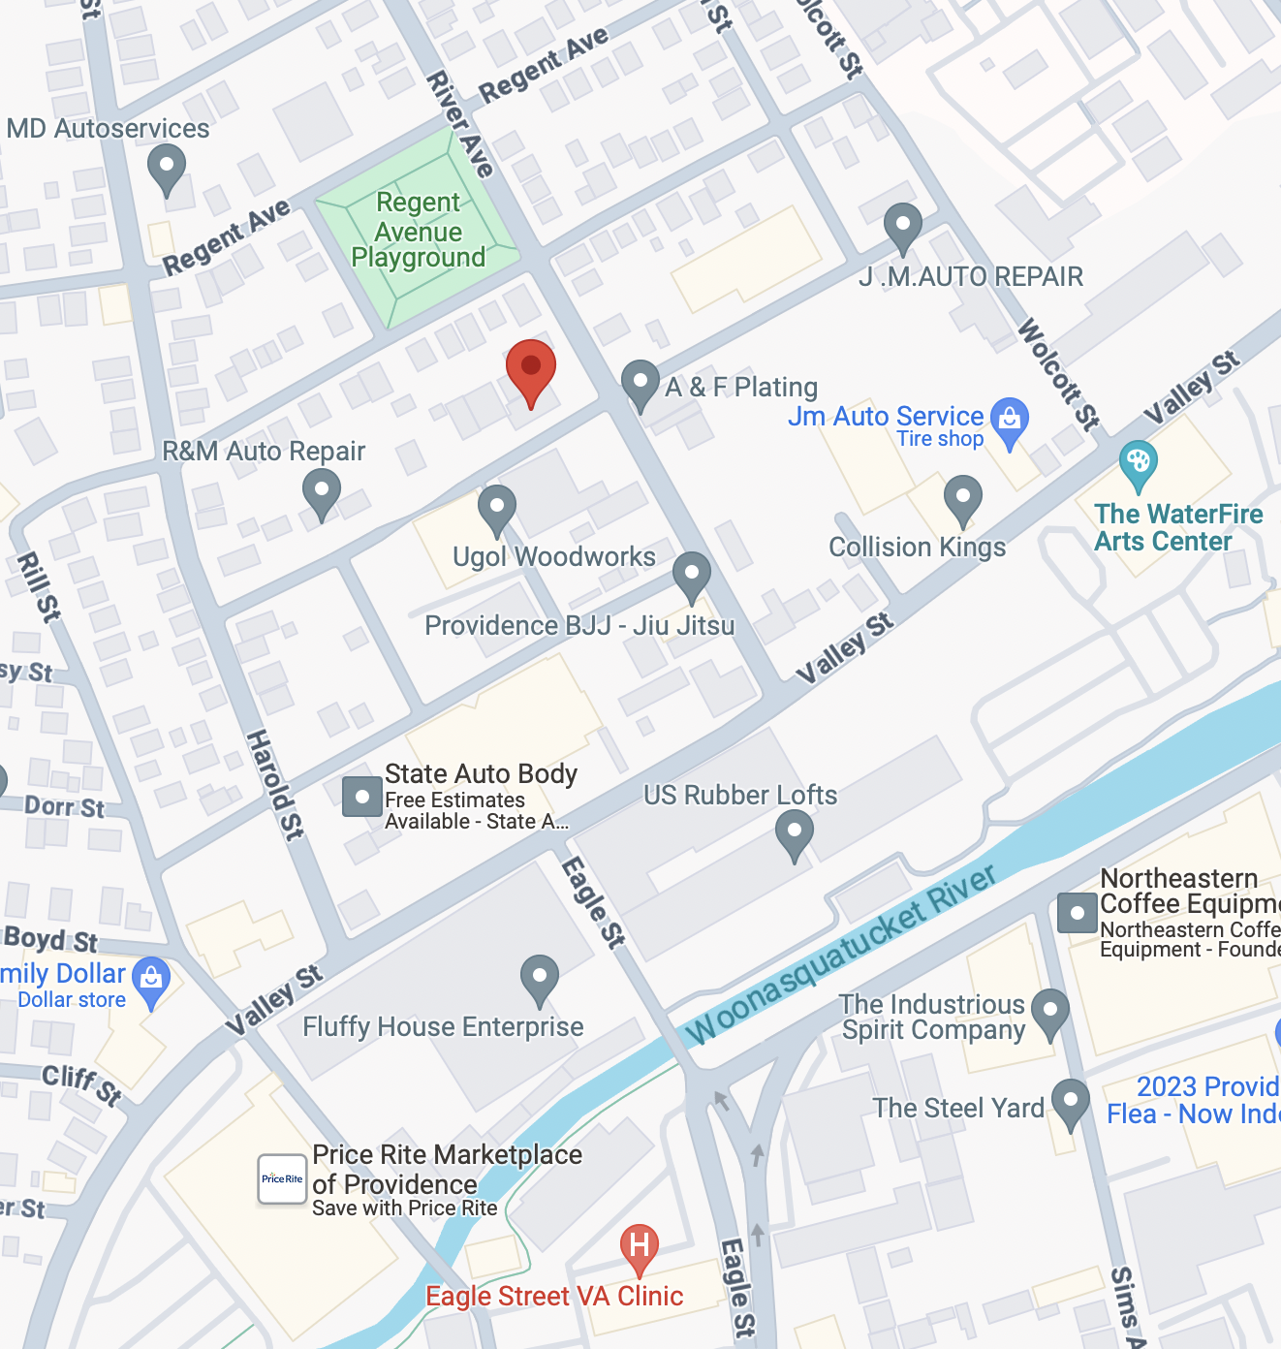
52 River Ave. prospective site
Dan has signed a P&S with the current owner of 52 River Ave, contingent on our ability to secure proper zoning for Shelito’s Way Gym.
We are currently unclear as to what steps are necessary to move forward with the project at this prospective site.

Slide 6
52 River Ave. prospective site
Zoning: M-1
Plat/Lot: 65/152
Lot size: 11,020 SF
Located between Valley St. and Chalkstone Ave. at the northwest corner of River Ave. and Prescott Street.

Slide 7
52 River Ave. existing structure
Built circa 1930
Single story with basement
Masonry & steel beam
5,798 SF above ground
2698 SF of basement
38’ of frontage on River Ave.
15+ parking spaces

Slide 8
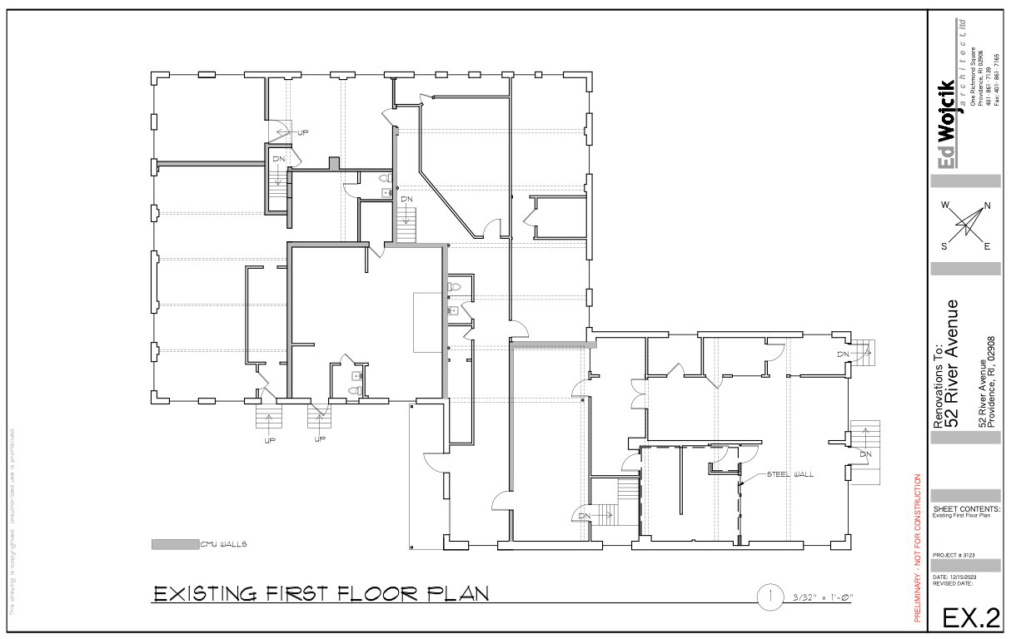
52 River Ave. existing first floor
Partitioned into many (5-6) irregularly shaped and nested units.
Three (3) existing bathrooms

Slide 9
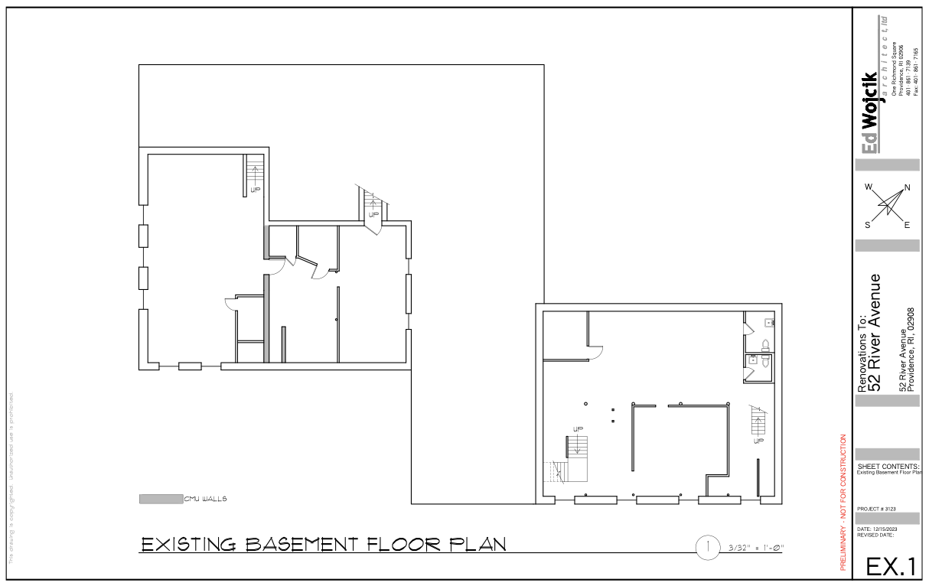
52 River Ave. existing basement
Three (3) smaller areas and one (1) large space.
Two (2) bathrooms.

Slide 10
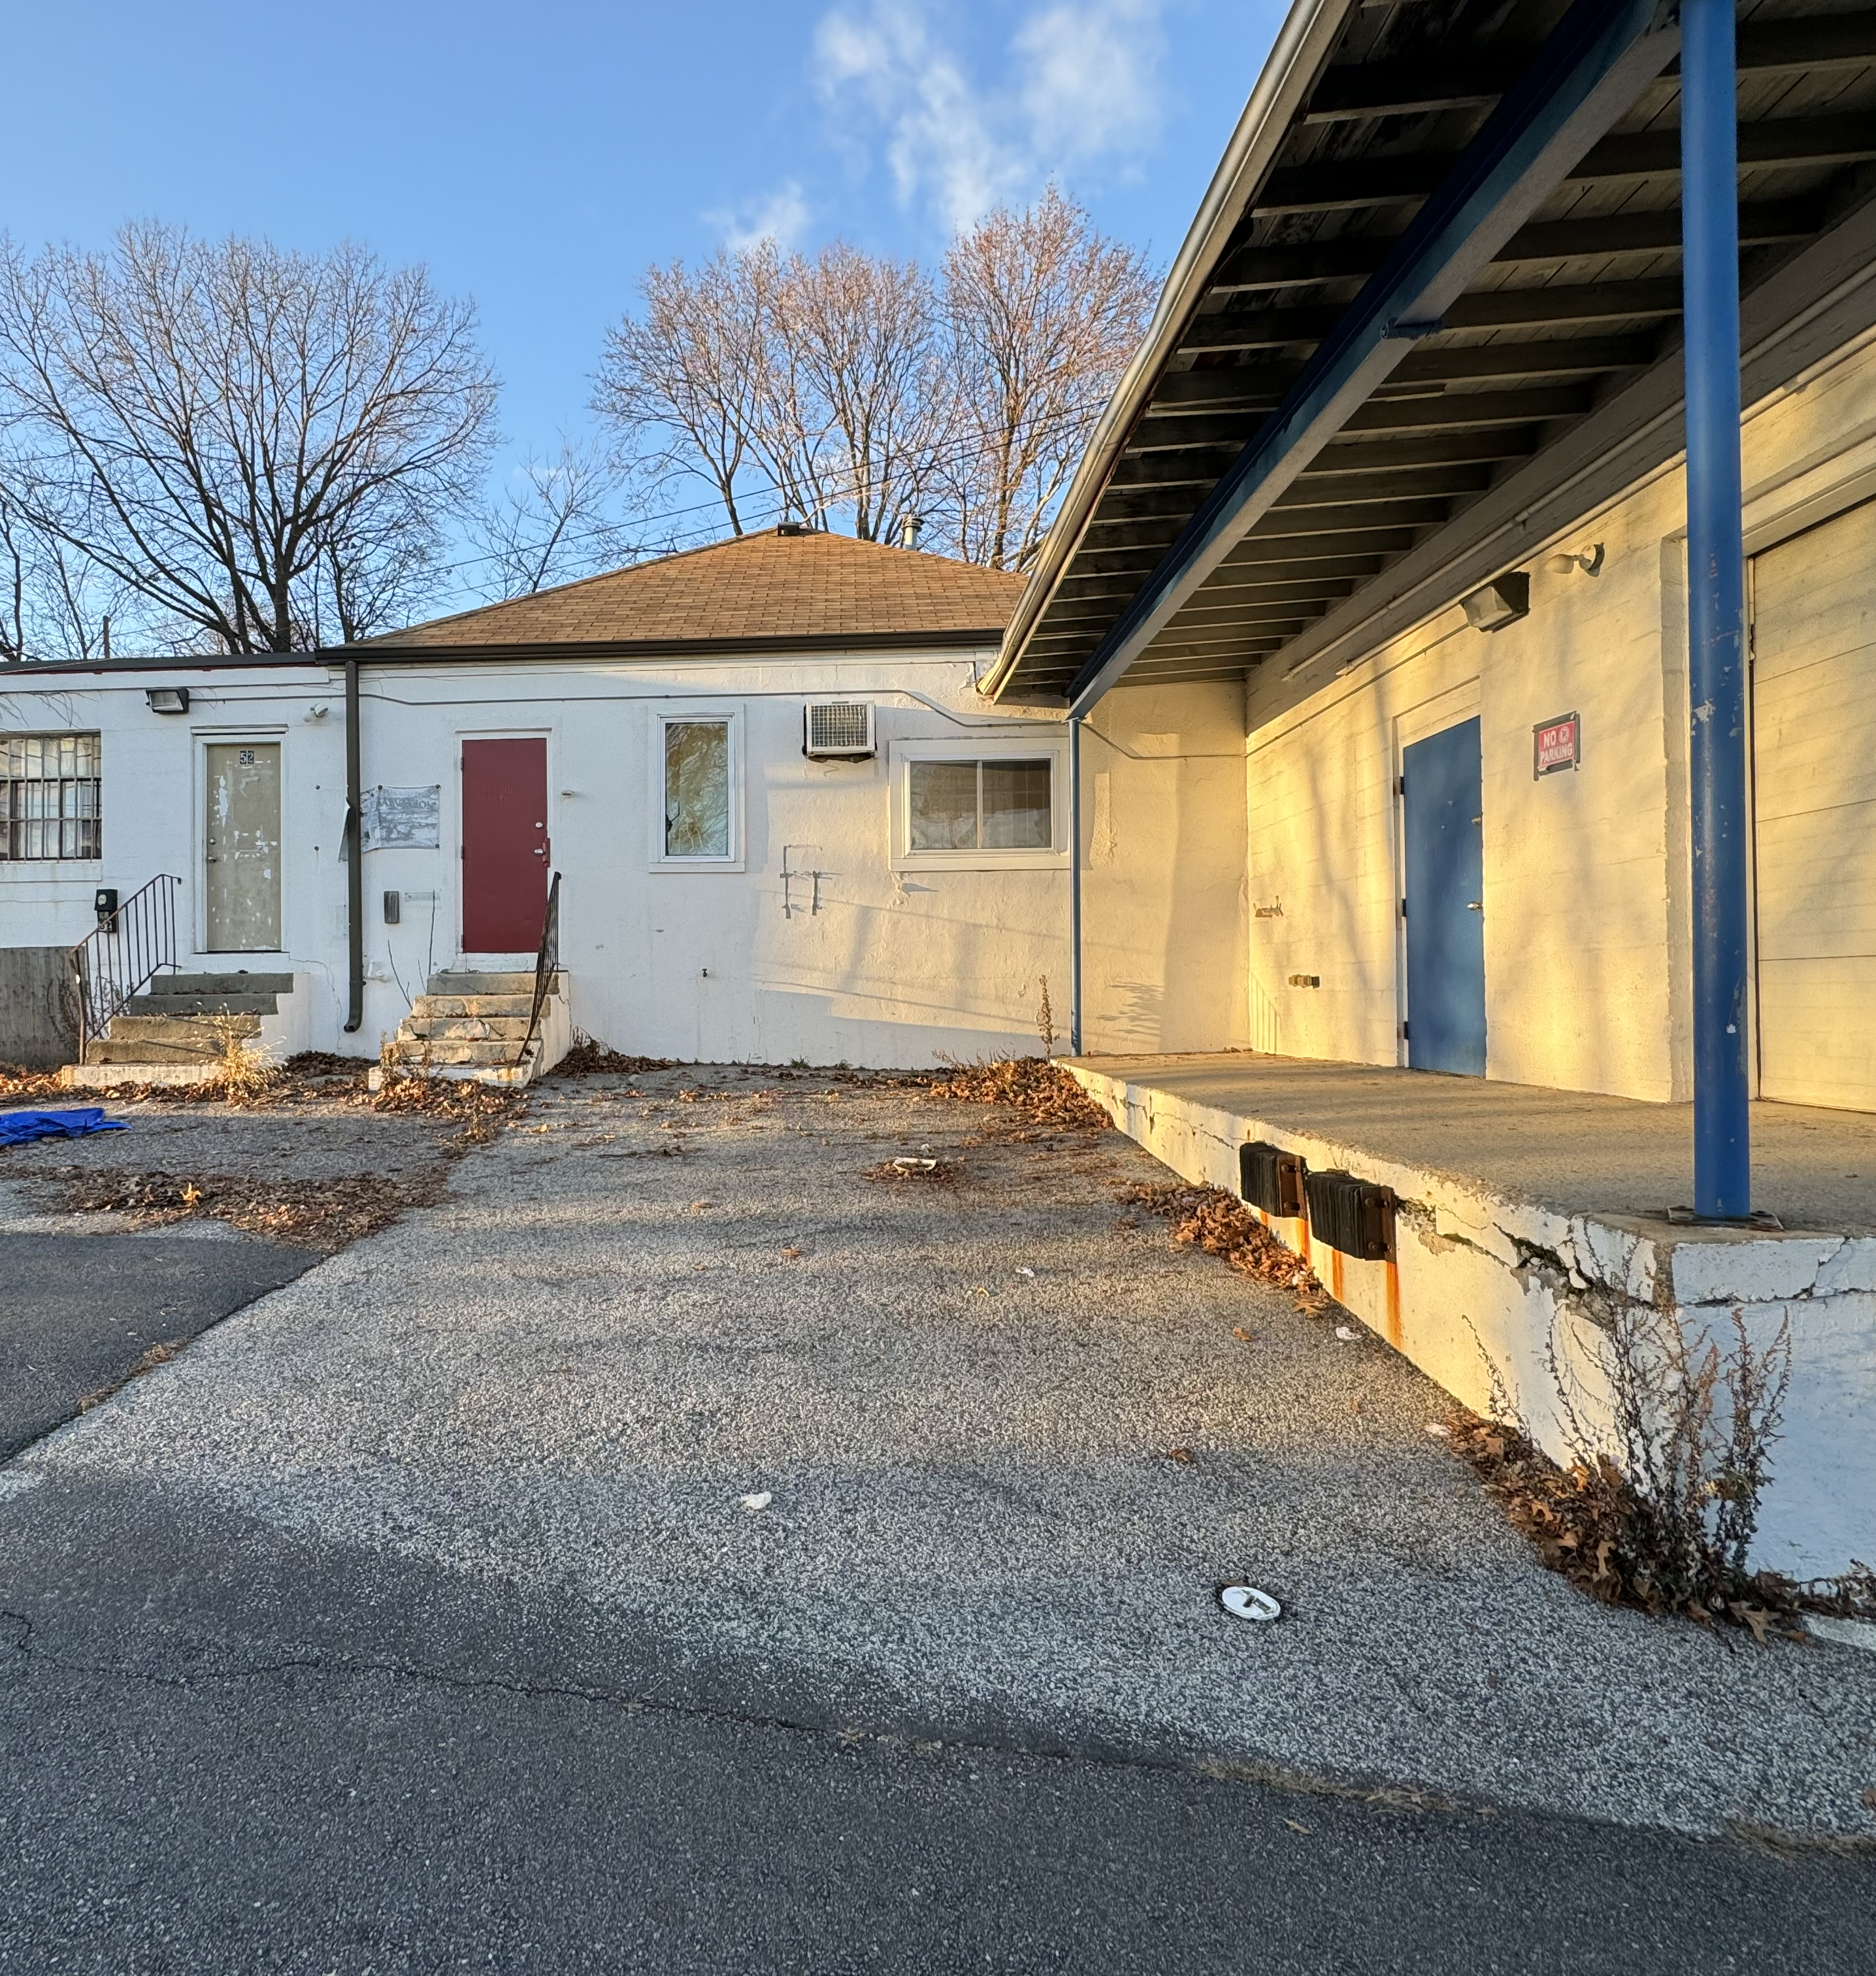
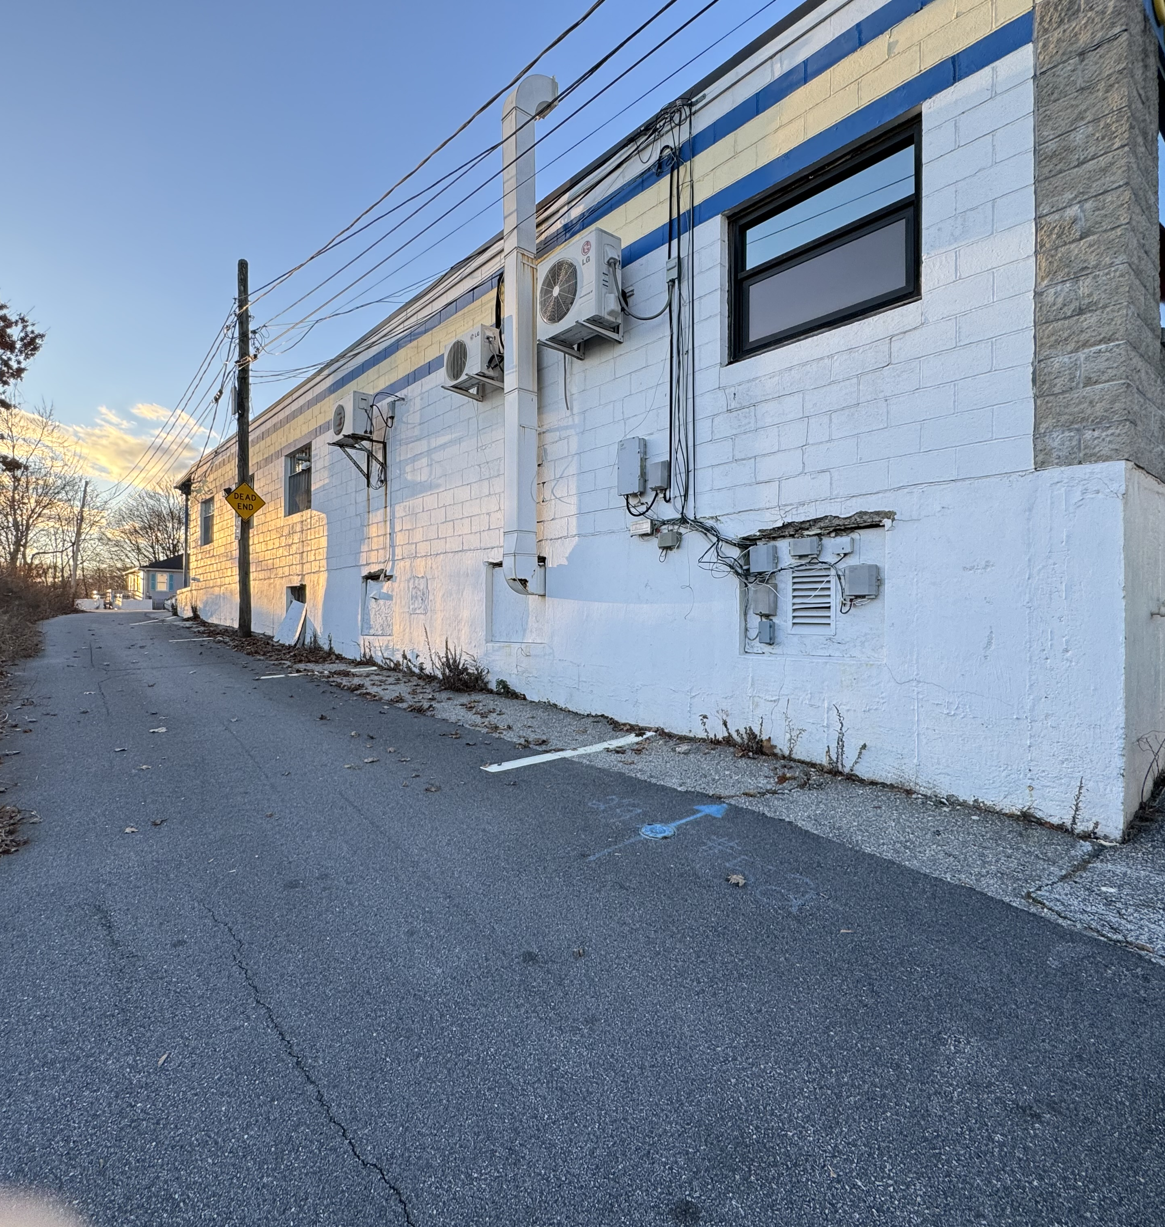
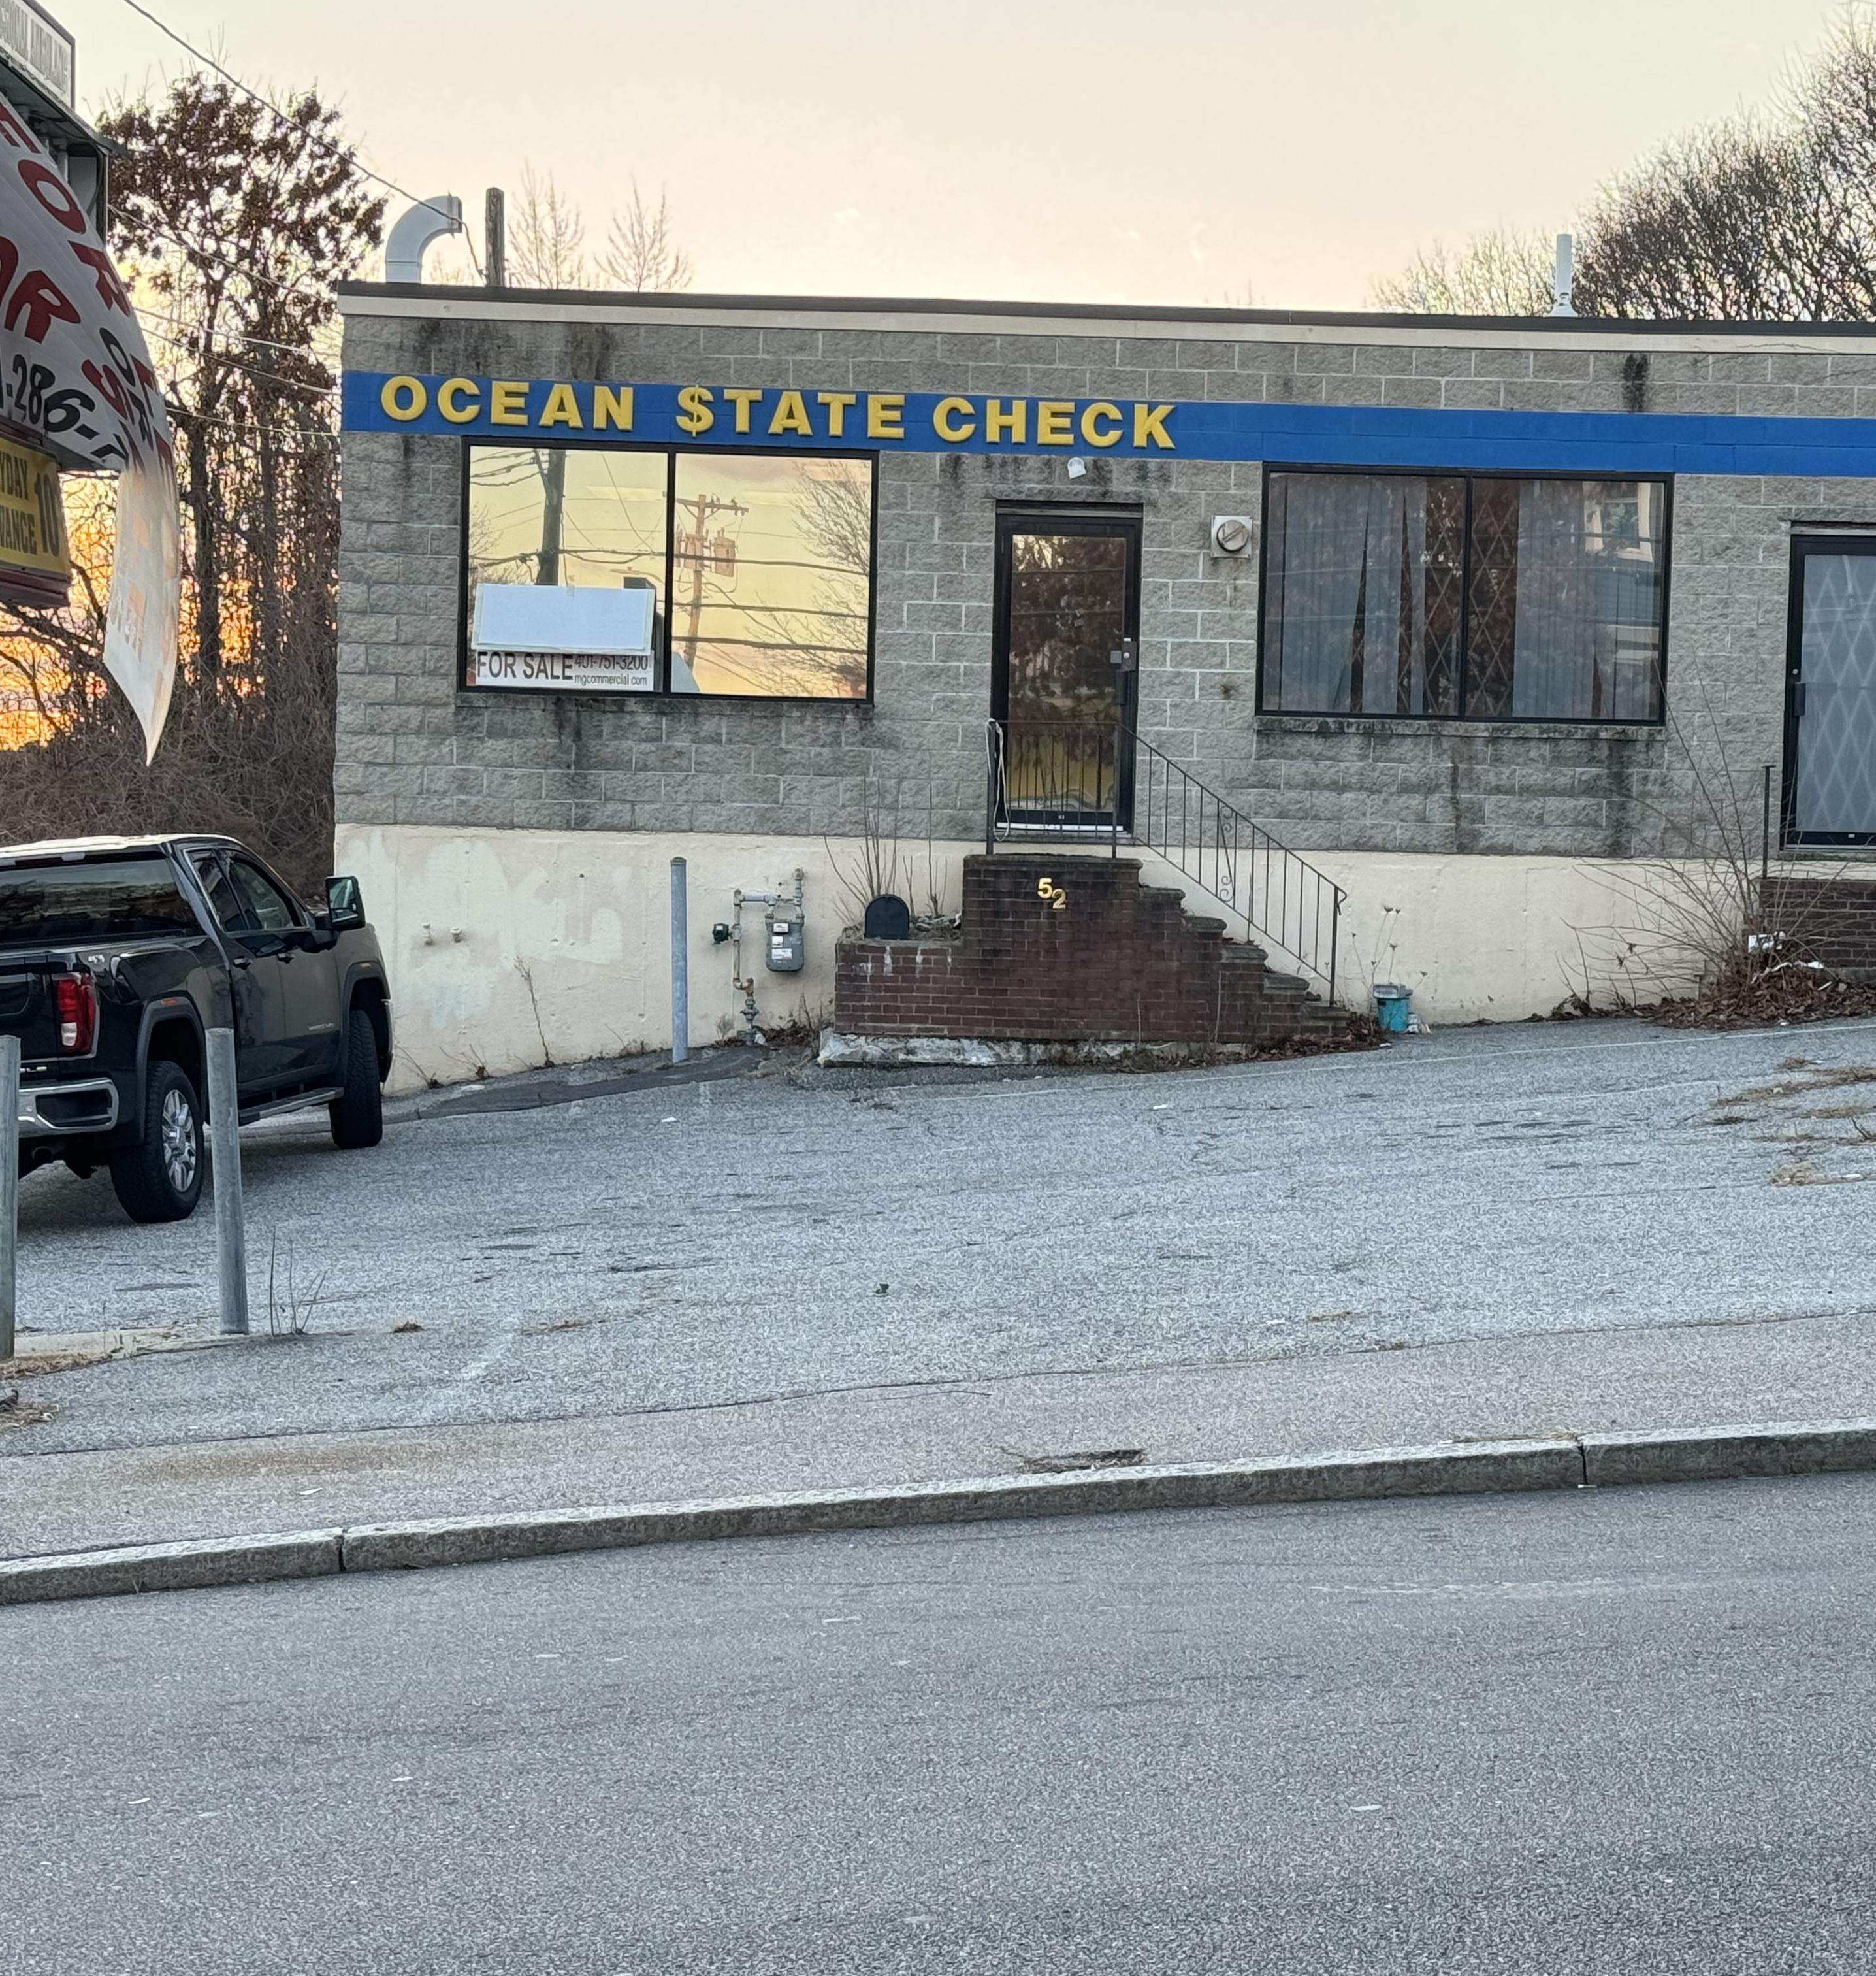
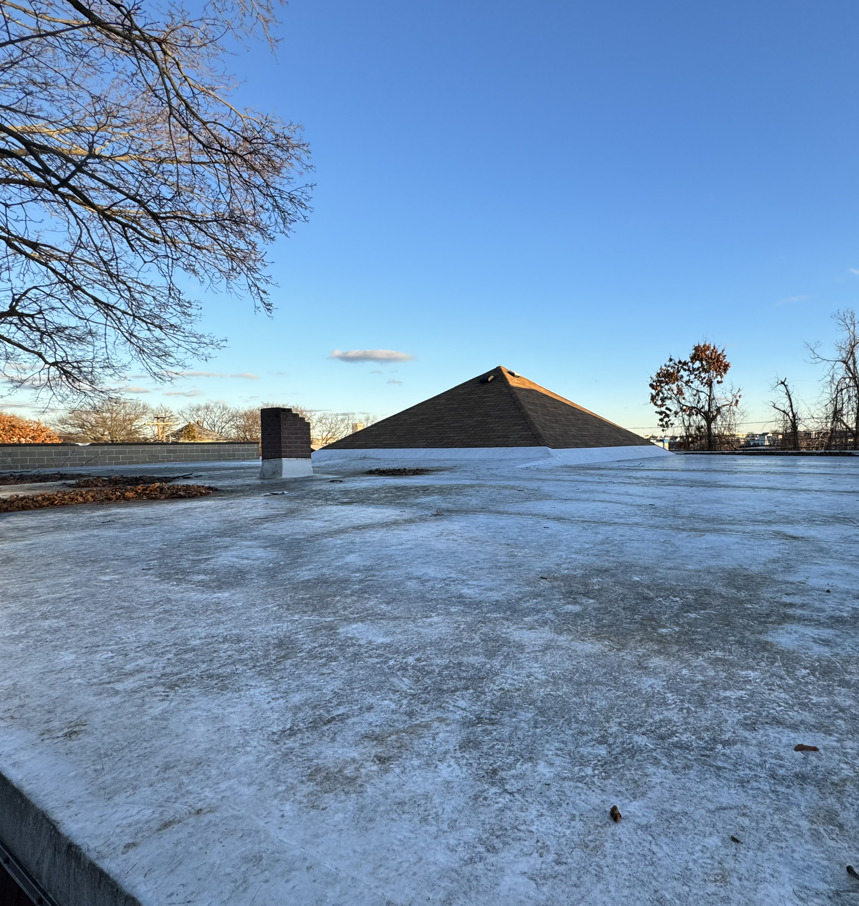
52 River Ave. current conditions
Empty for 2 years
Stable but distressed:
Roof damage (assessed by Chaffee Roofing).
Cracked foundation
Non-functioning plumbing
Water damage, mold & mildew
Pests
Overgrown landscaping
Garbage dumping

Slide 11
52 River Ave. current conditions
CLICK FOR VIDEO TOUR OF MAIN AREA FOR GYM

Slide 12
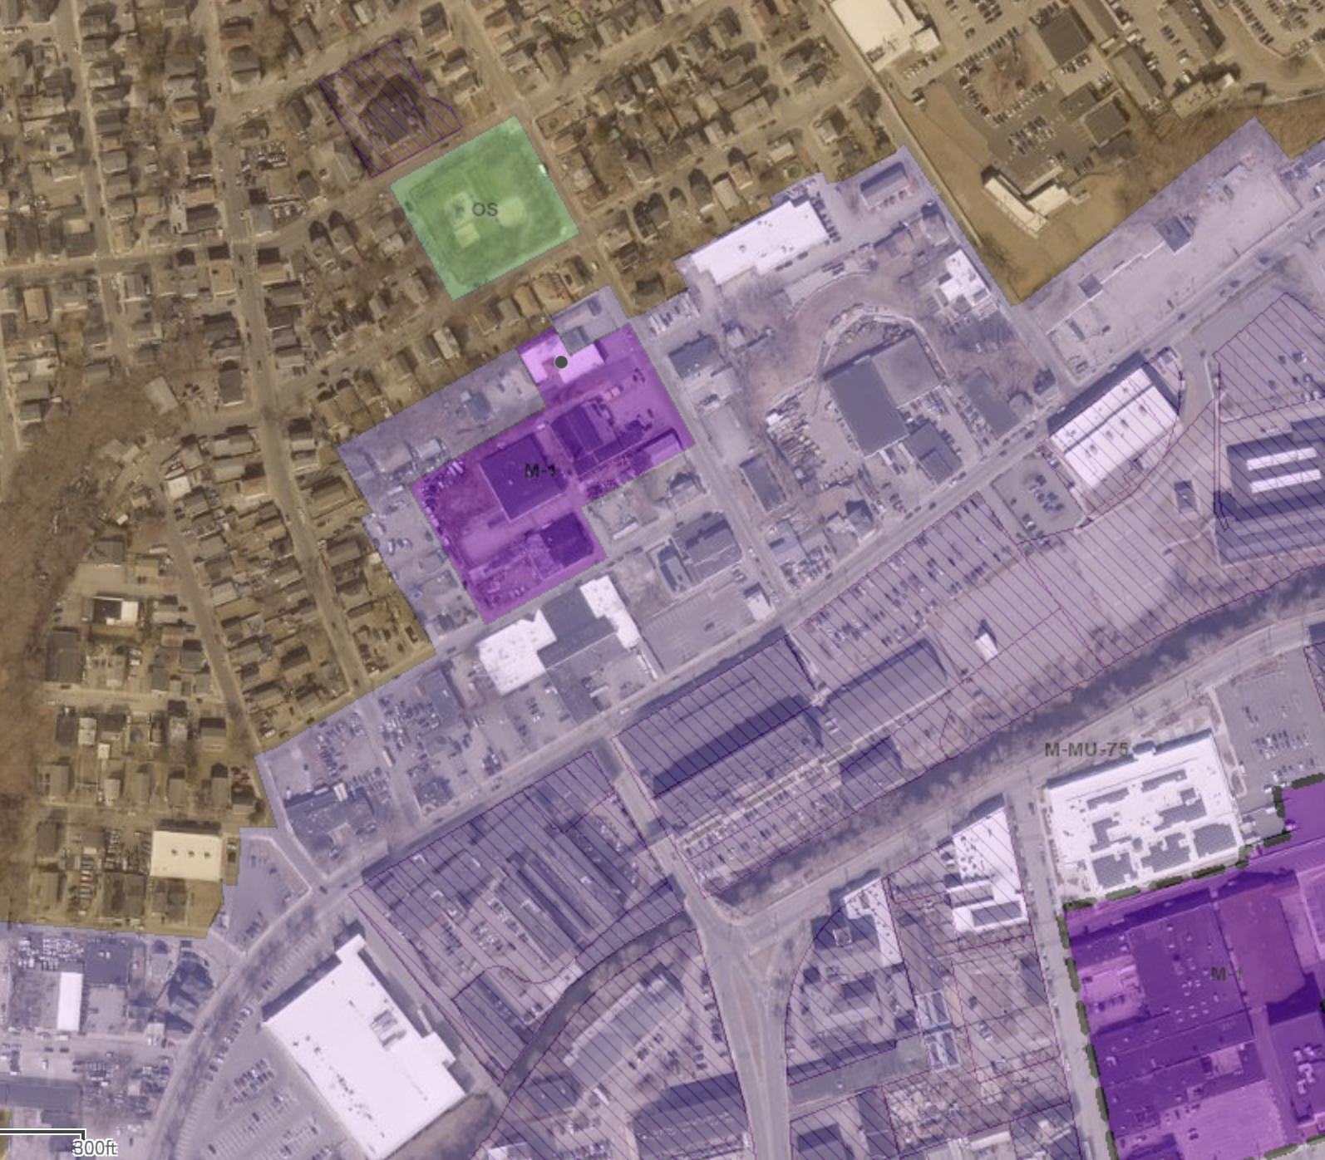
52 River Ave. neighborhood & abutters
OS
R3
RIVER AVE
M-1
VALLEY ST
Immediately adjacent plats are all Zoned M-MU-75.
Broader Valley neighborhood primarily R-3
M-MU neighbors include:
East Coast Screen Printing
Ultra Metal Finishing
A&F Plating
Ugol Woodworking
Providence Brazilian Jui Jitsu
Universal Plating
RI Stamped Concrete Services
M-MU-75
M-1
EAGLE ST

Slide 13
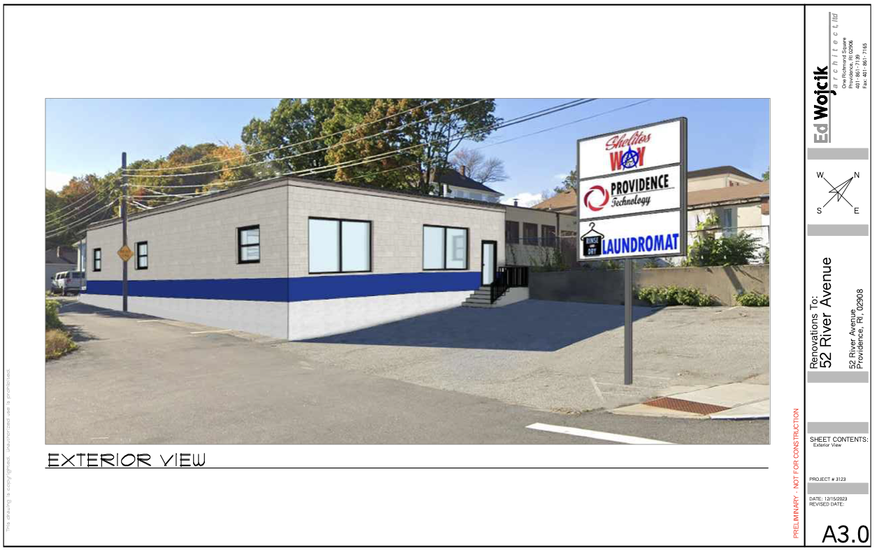
52 River Ave. proposed new structure
Mock-up of stabilized and cosmetically improved exterior, removing duplicate front entrance, and showing hypothetical new sign

Slide 14
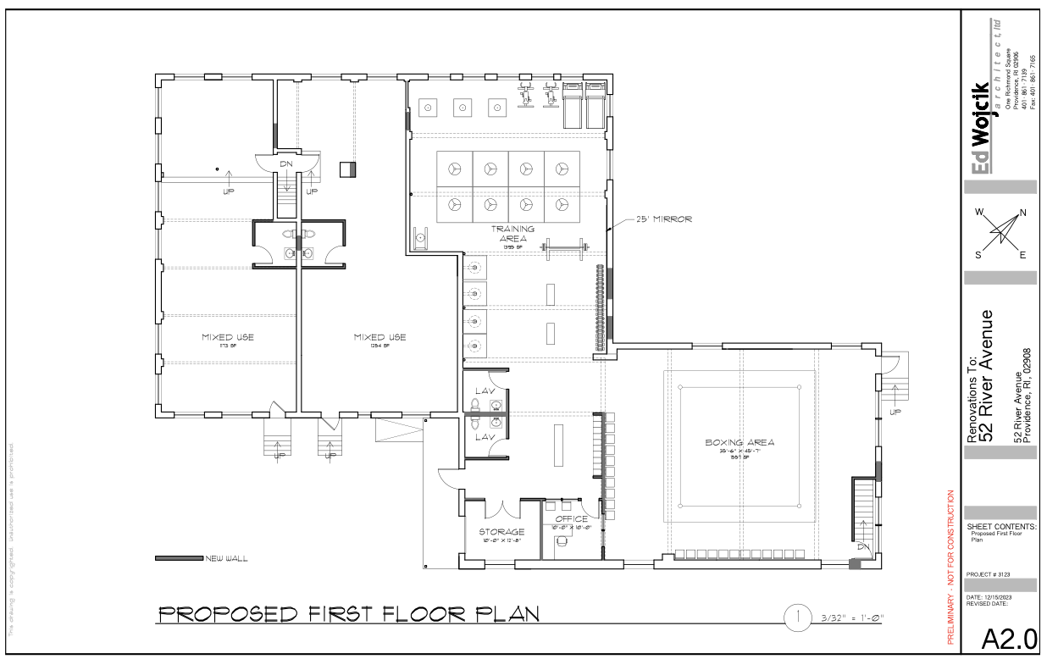
52 River Ave. proposed new structure
Gut renovate the first floor
Unit 1: 3371 SF, 2 Bathroom
Tenant: Shelito’s Way Gym
Unit 2: 1254 SF, 1 Bathroom
Tenant: TBD
Unit 3: 1173 SF, 1 Bathroom
Tenant: TBD

Slide 15
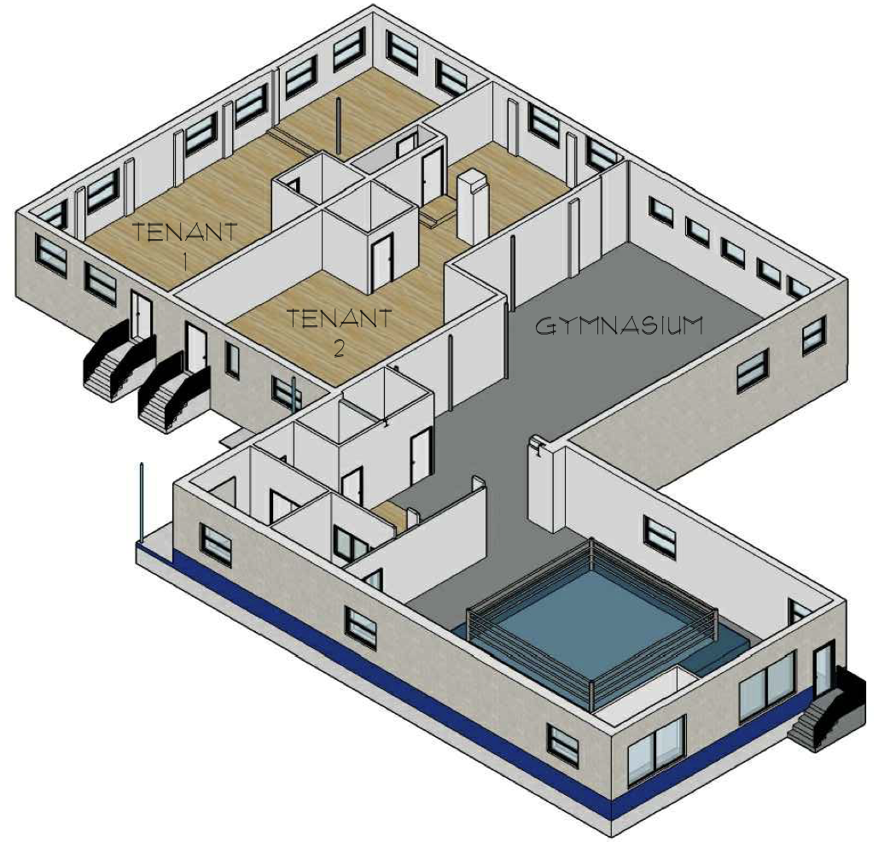
52 River Ave. proposed new structure
Gut renovate the first floor
Unit 1: 3371 SF, 2 Bathroom
Tenant: Shelito’s Way Gym
Unit 2: 1254 SF, 1 Bathroom
Tenant: TBD
Unit 3: 1173 SF, 1 Bathroom
Tenant: TBD

Slide 16
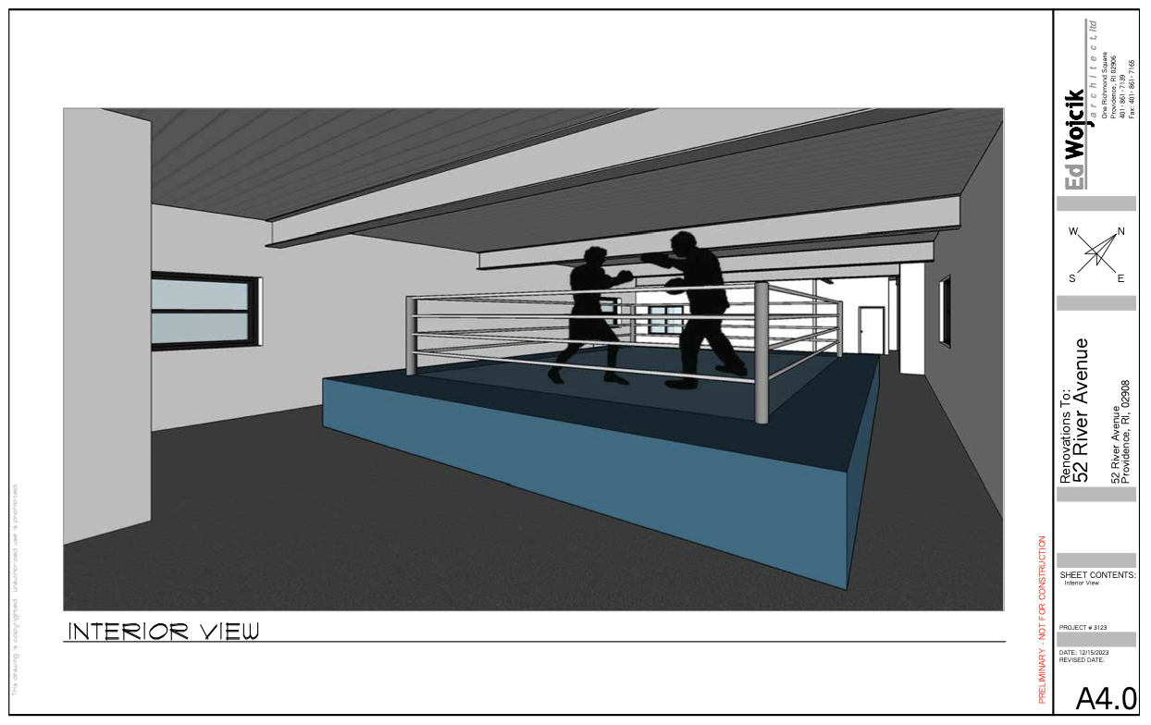
52 River Ave. proposed new structure
Mock-up of boxing ring in renovated and opened space.

Slide 17
52 River Ave. planned investment
ARCHITECTS $25,000.00 ROOF $25,000.00 ELECTRICAL $27,500.00 DEMO $20,000.00 PAINT $20,000.00 PLUMBING $30,000.00 SURVEY $5,000.00 MASONRY $20,000.00 CARPENTRY $40,000.00 CONTINGENCY $31,875.00 _________________________________
INVESTMENT ESTIMATE $244,375.00

Slide 18
52 River Ave. possible tenant uses & zoning pathways
TENANT | Keep M-1 Zoning | Re-zone M-MU | Re-zone C1
Shelito’s Way Gym
TBD Tenant #2 | Adult store, Bar, Broadcasting facility, Compassion Center, Contractor Storage, Vocational School, Financial Institution, Government Office, Greenhouse/Nursery – Retail. Healthcare Institution, Heavy Retail/Rental/Service, Industrial (Artisan, General, Light), Industrial Design, Live Entertainment Ancillary Use, Lodge/Meeting Hall, Medical/Dental Office, Micro Brewery-Distillery, Movie Studio, Office, Playground, Personal Service Establishment, Public Safety or Public Works Facility, Rehab Center, R&D, Restaurant, Retail Goods, Retail Alcohol, Self-Storage Facility, Ship and Boat building, Solar Energy System, Specialty Food Service, Vehicle Dealership, Vehicle Repair/Service, Vehicle Rental, Warehouse, Wholesale Establishment, Wireless Telecommunications.* | Amusement/Sports Facility – Indoor, Animal Care Facility, Art Gallery, Art Studio, Bar, Body Modification Studio, Broadcasting Facility, Community Center, Community Residence, Compassion Center, Cultural Facility, Day Care, Dwelling, Educational Facility, Financial Institution, Government Office, Greenhouse/Nursery Retail, Healthcare Institution, Heavy Retail, Hotel/Motel, Industrial (Artisan, General, Light), Industrial Design, Live Entertainment Ancillary Use, Lodge/Meeting Hall, Medical/Dental Office, Micro-brewery/Distillery, Movie Studio, Office, Outdoor Dining, Outdoor Market, Park/Playground, Passenger Terminal, Personal Service Establishment, Place of Worship, Plant Agriculture, Public Safety Facility, Reception Facility, R&D, Restaurant, Retail Goods, Retail Alcohol, Ship & Boat Building/Repair, Solar Energy System, Specialty Food Service, Utility, Vehicle Dealership/Repair/Service, Vehicle Rental, Wholesale Establishment.* | Animal Care Facility, Art Gallery, Art Studio, Bed & Breakfast, Body Modification Establishment, Broadcasting Facility, Community Center, Community Residence, Cultural Facility, Day Care, Dwelling, Educational Facility, Financial Institution, Gov’t Office, Group Quarters, Hotel/Motel, Industrial Design, Lodge/Meeting Hall, Medical/Dental Office, Office, Outdoor Dining, Outdoor Market, Park/Playground, Personal Service Establishment, Place of Worship, Plant Agriculture, Public Safety Facility, Residential Care Facility, Restaurant, Retail Goods, Utility,*
TBD Tenant #3
*Per Providence Zoning Ordinance (2014)

Slide 19
52 River Ave. next steps
Looking for guidance from Providence Zoning Office and legal representation to efficiently and expediently obtain the zoning approvals for this project.
Thank You!

